Slide 1
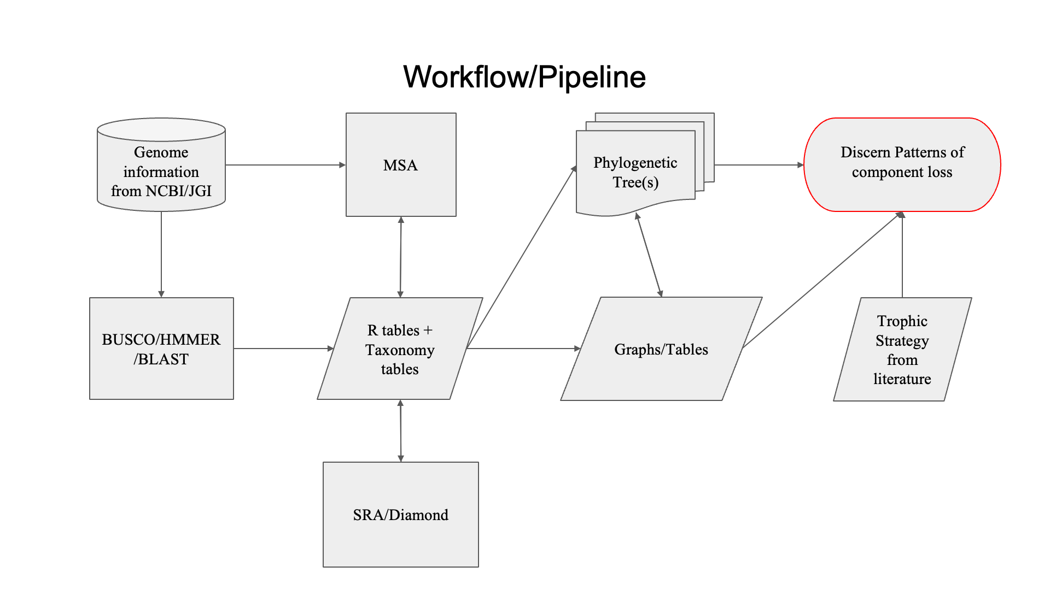


Figure 1

Slide 2
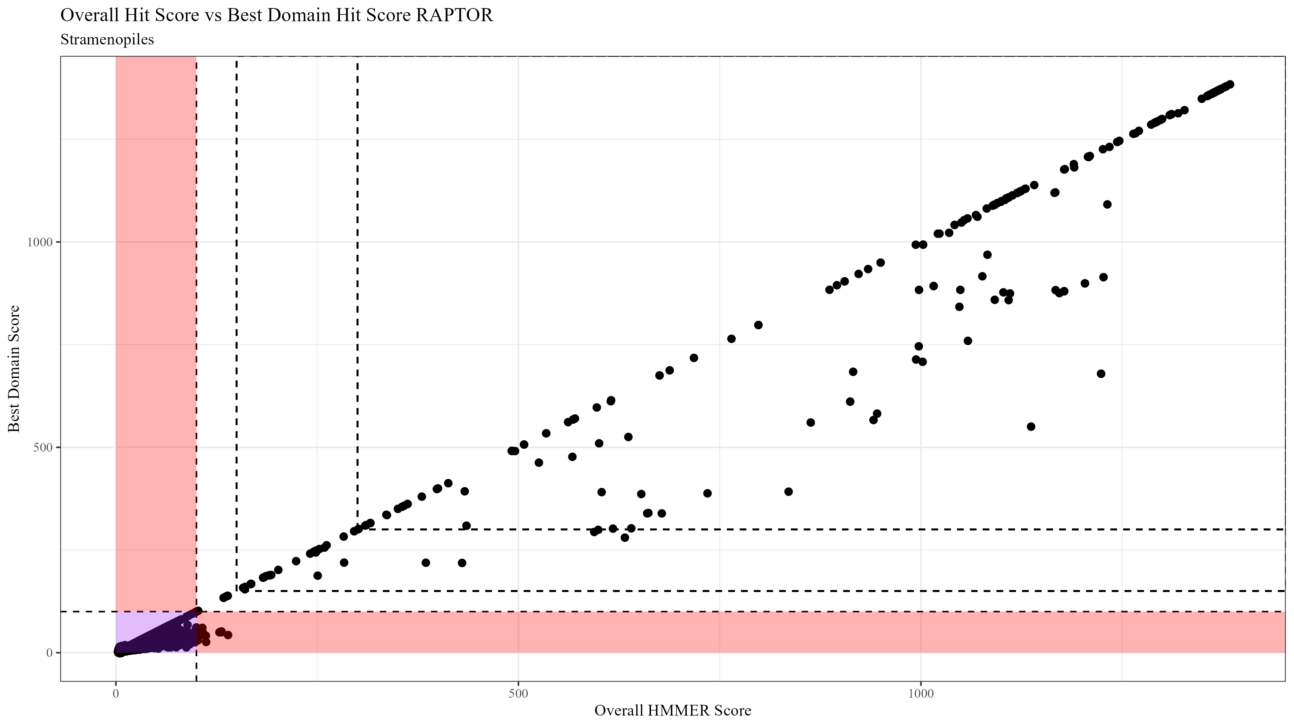
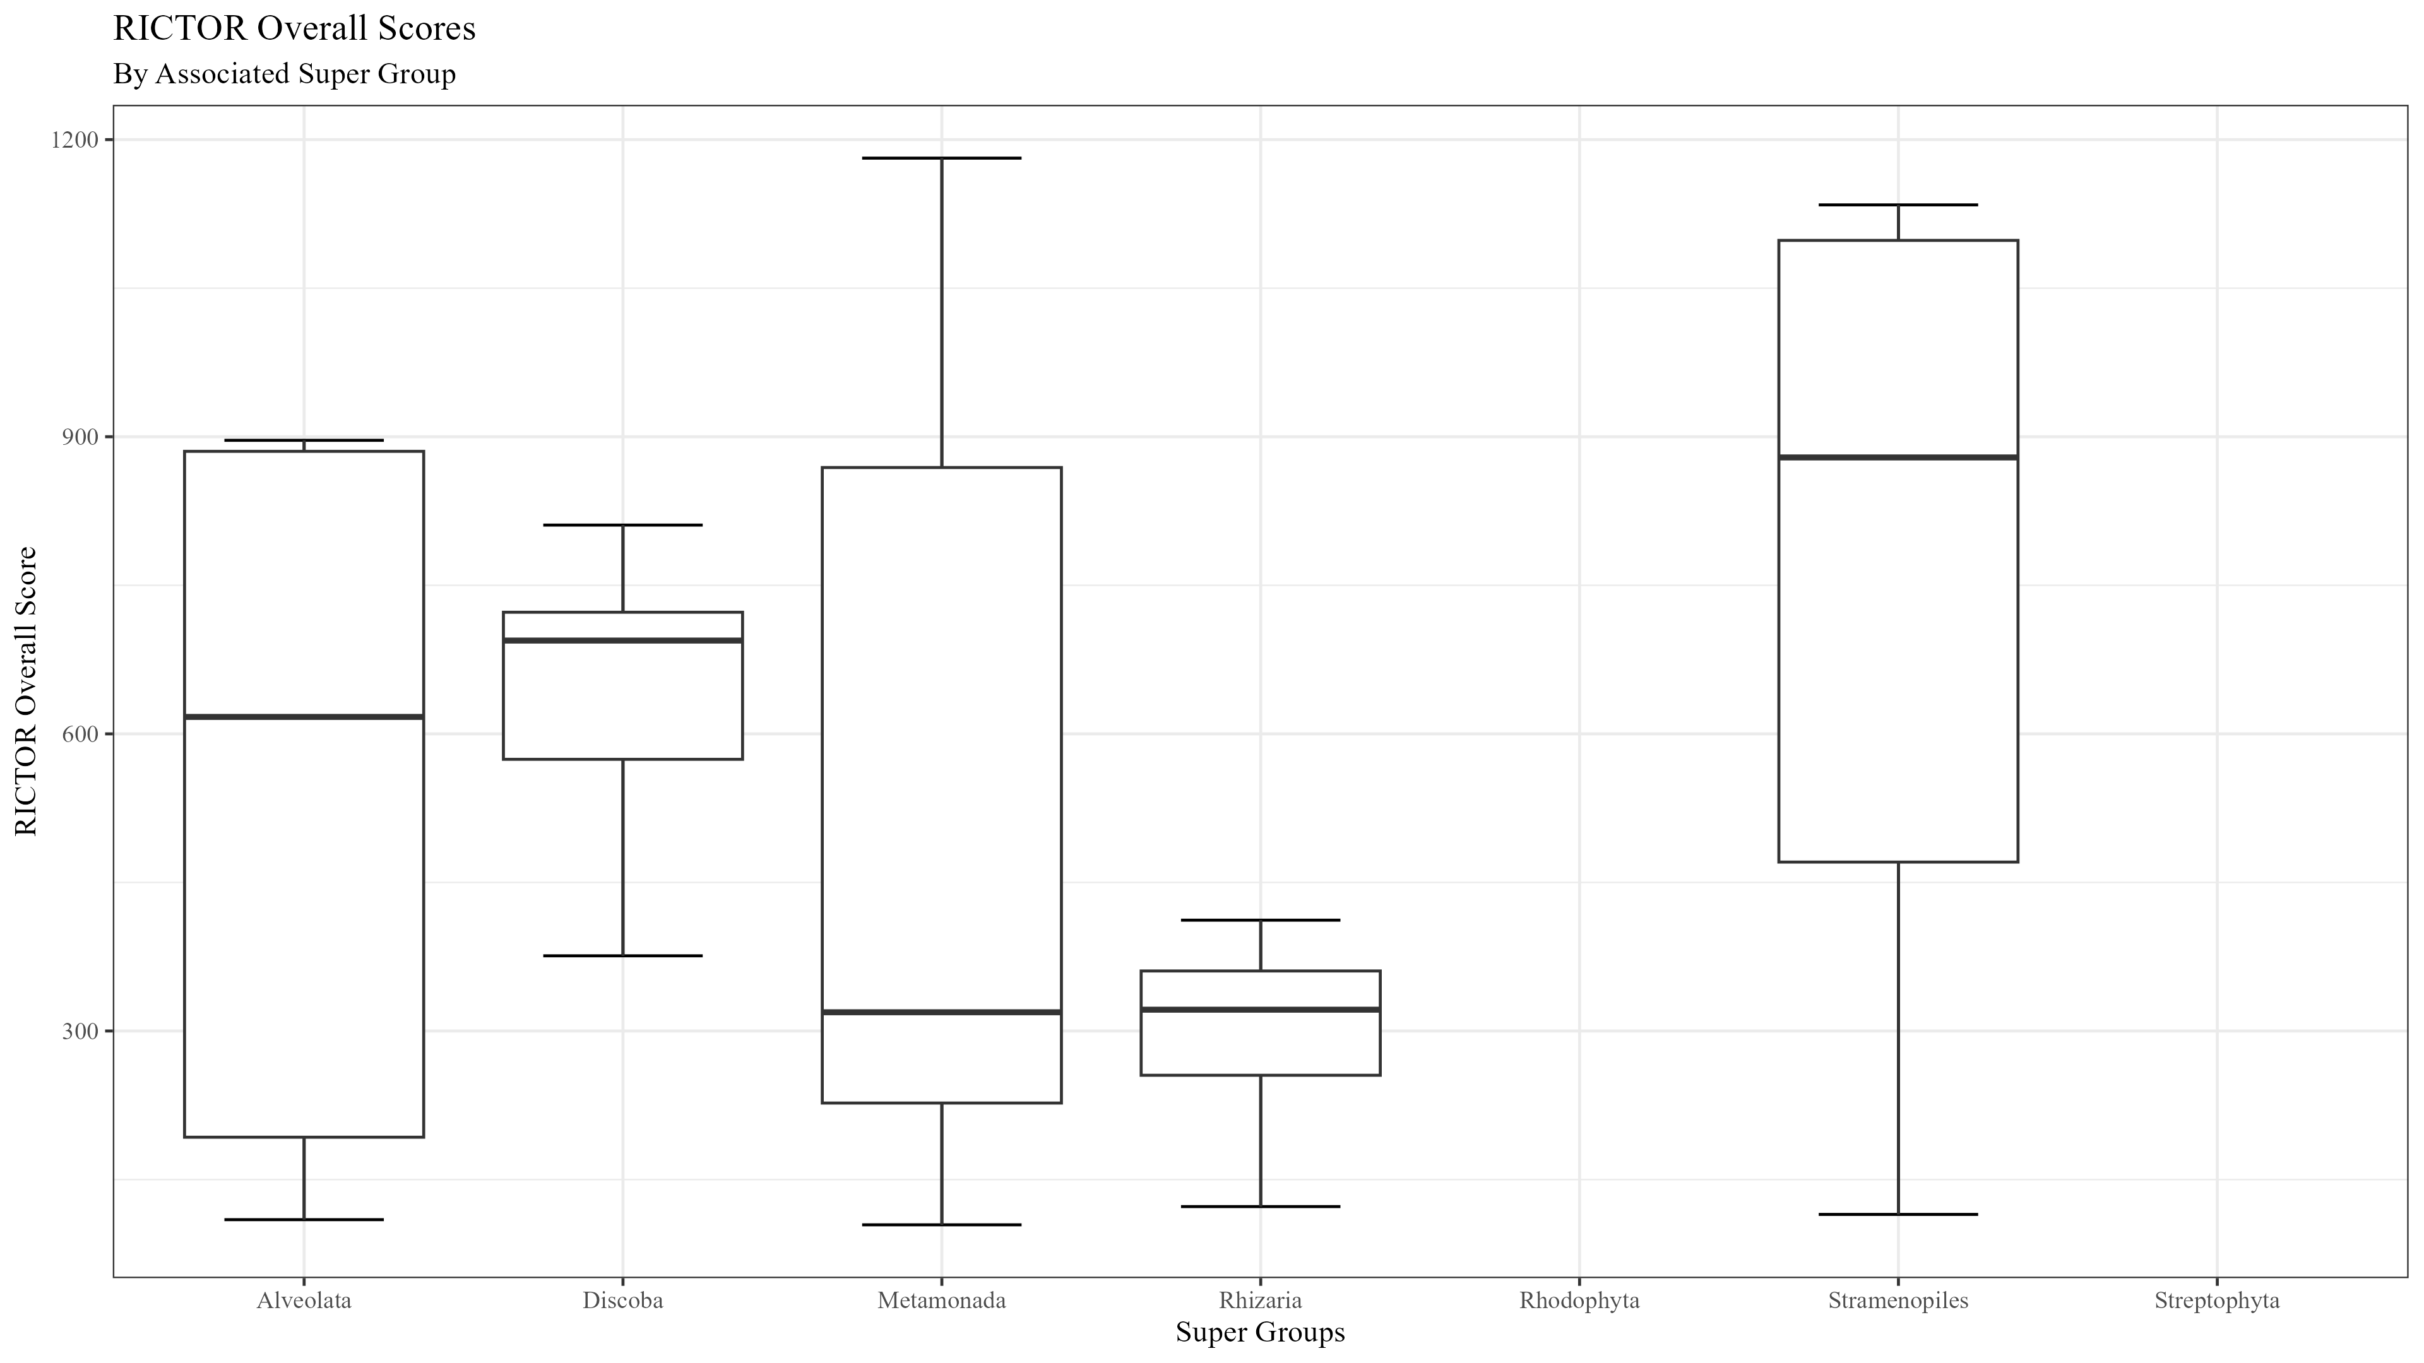
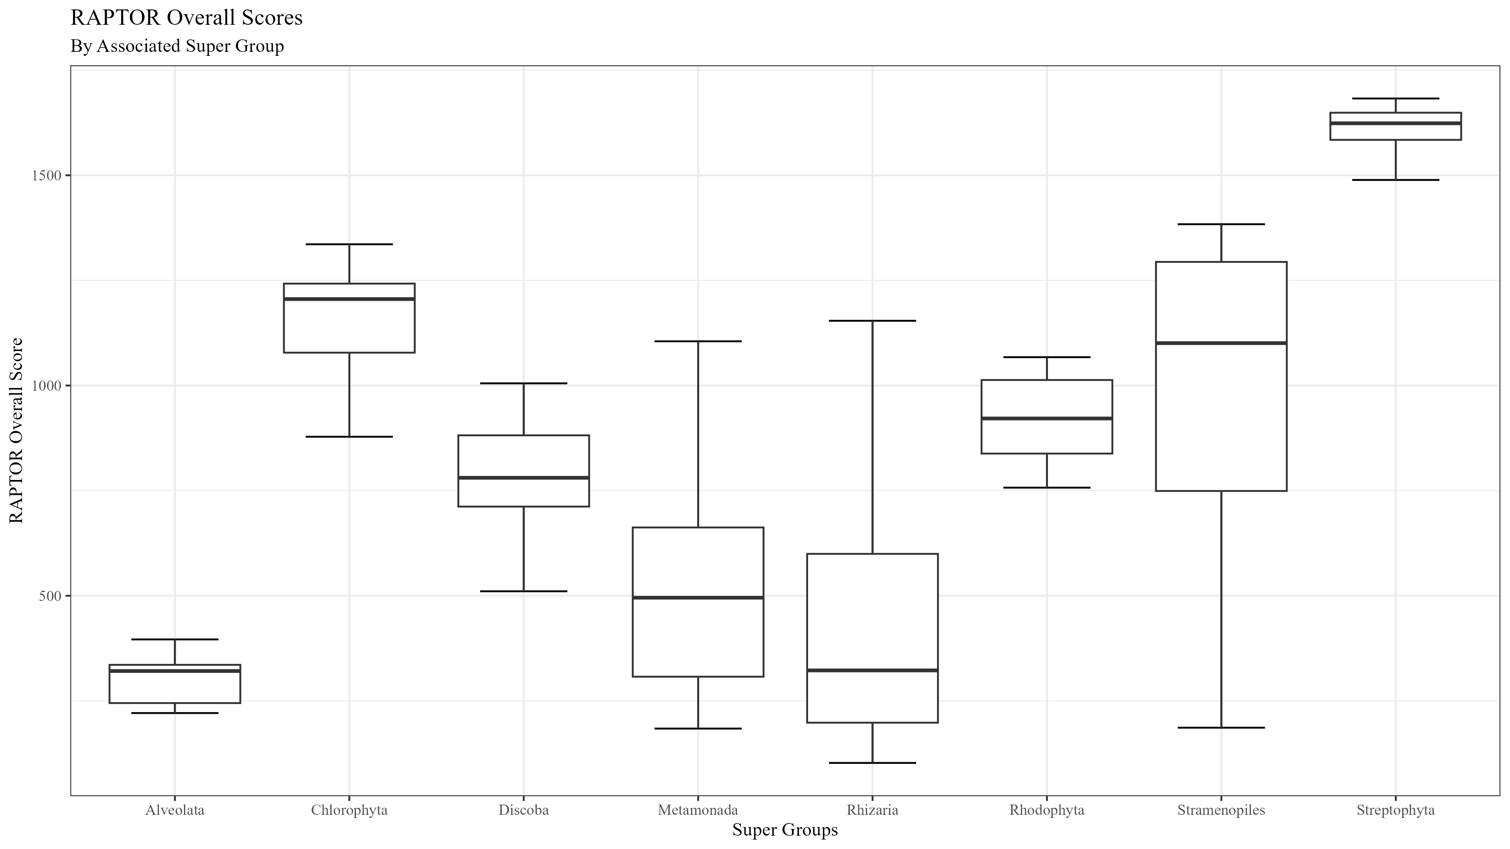
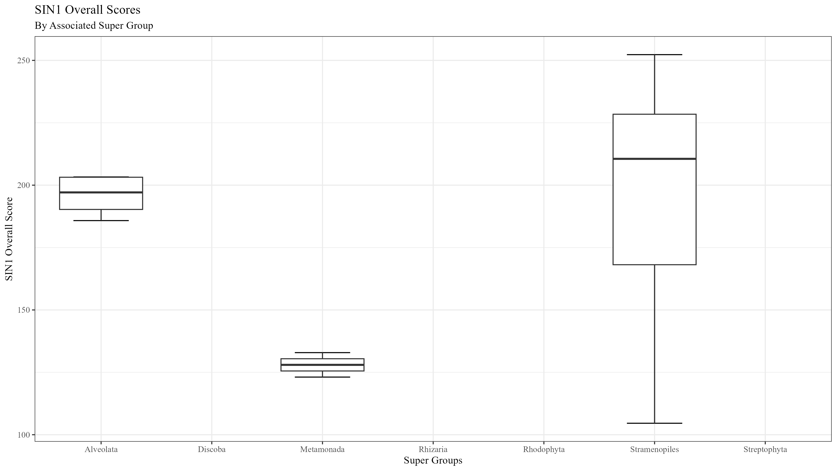
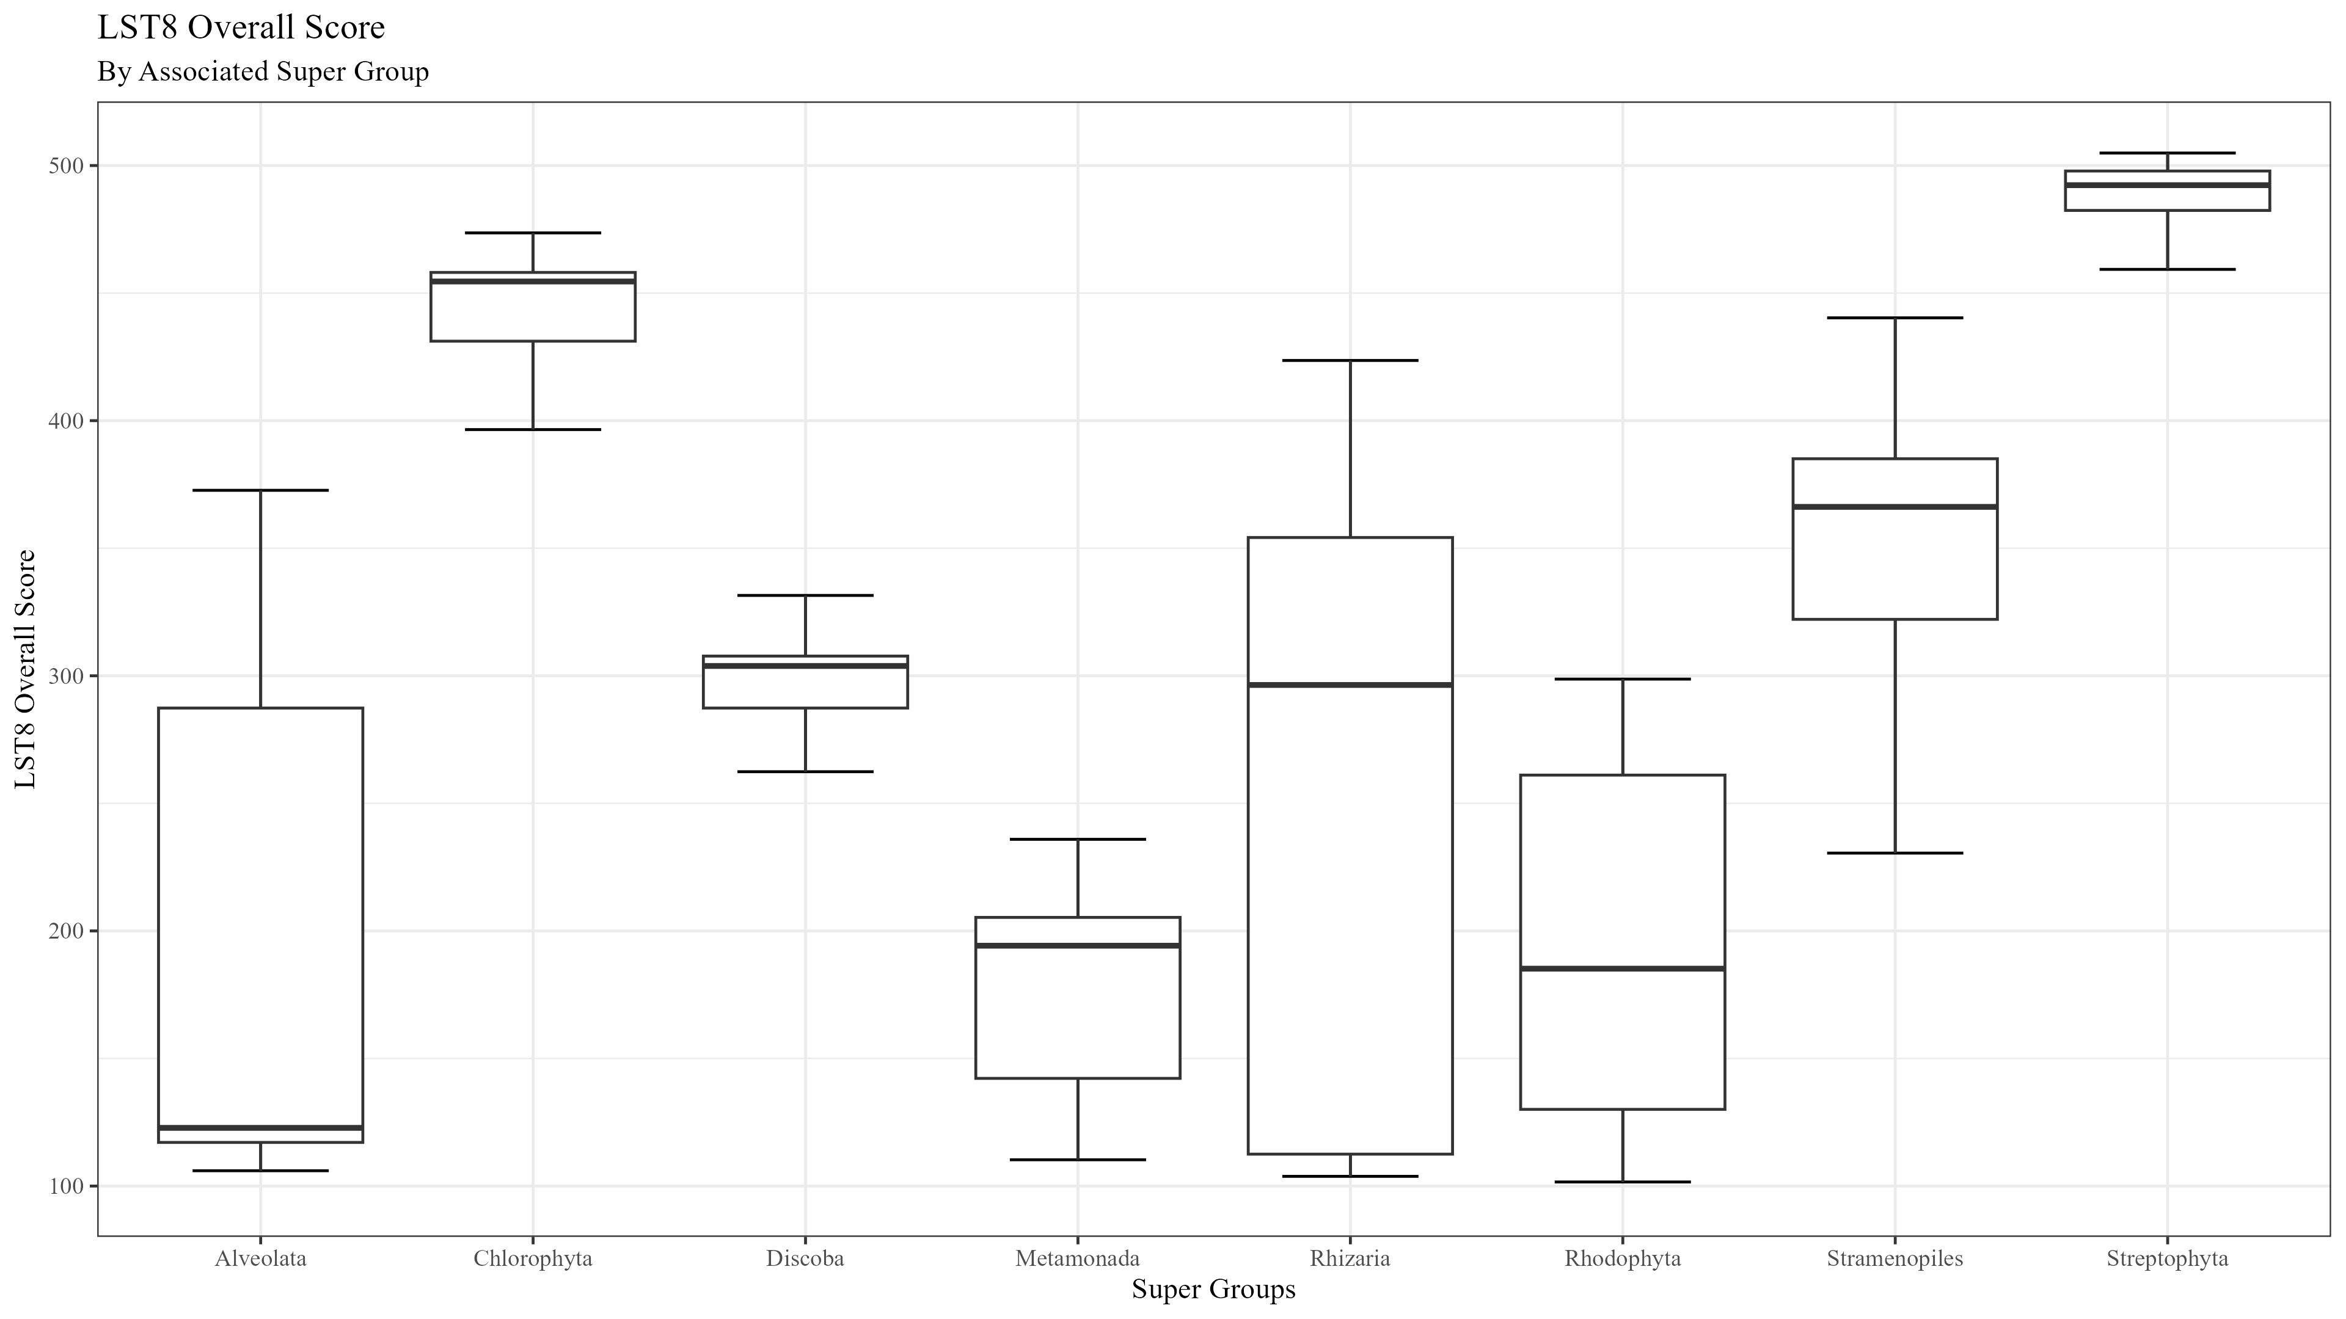

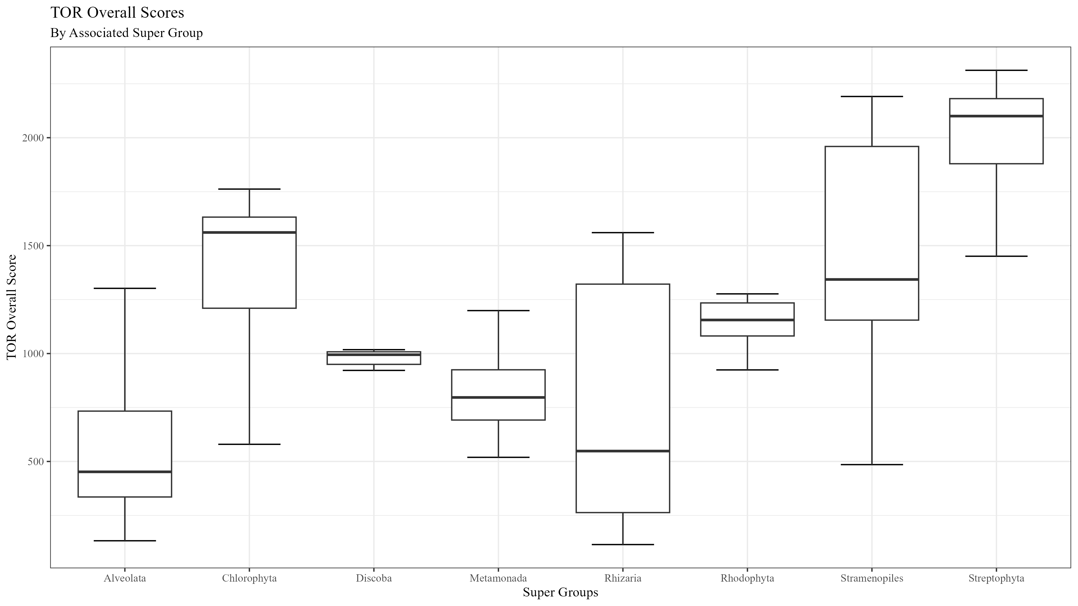
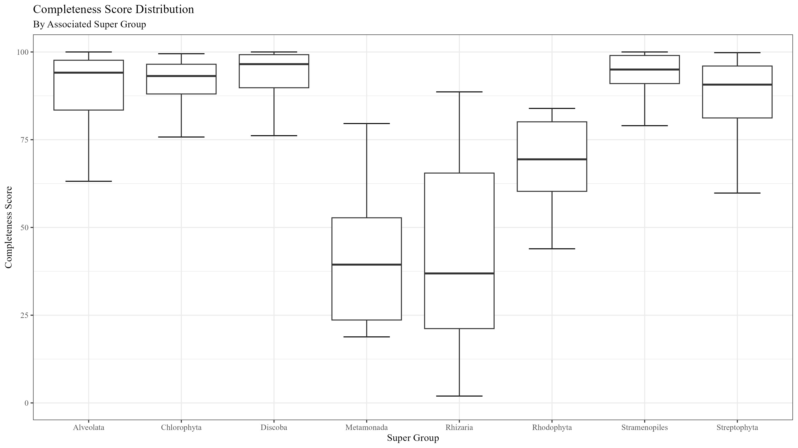
Figure 2

Slide 3










Figure 3
1
1694
RICTORN
RICTORM
RasGEF
Domain5
RICTOR Phosphorylation
ARM Repeats
Reference
High
Medium
Low
1
1353
RAPTORN
ARM Repeats
HEAT
ARM Repeats
WD-40 Repeats
Reference
High
Medium

Slide 4
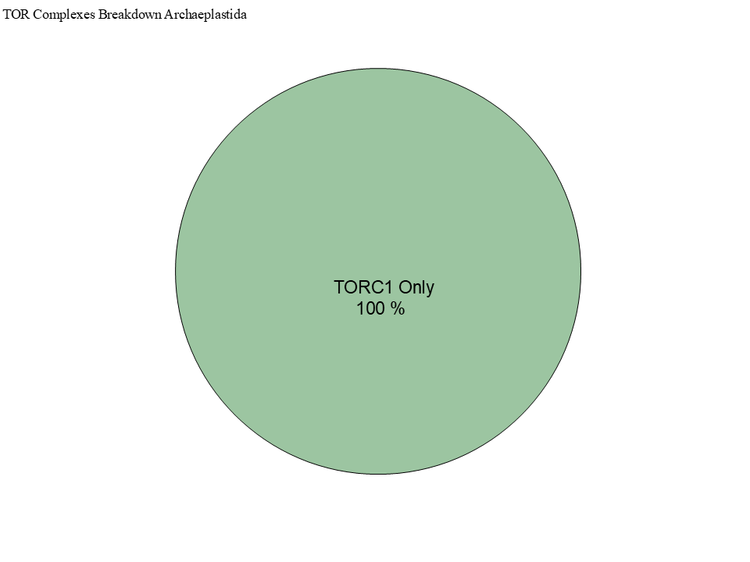
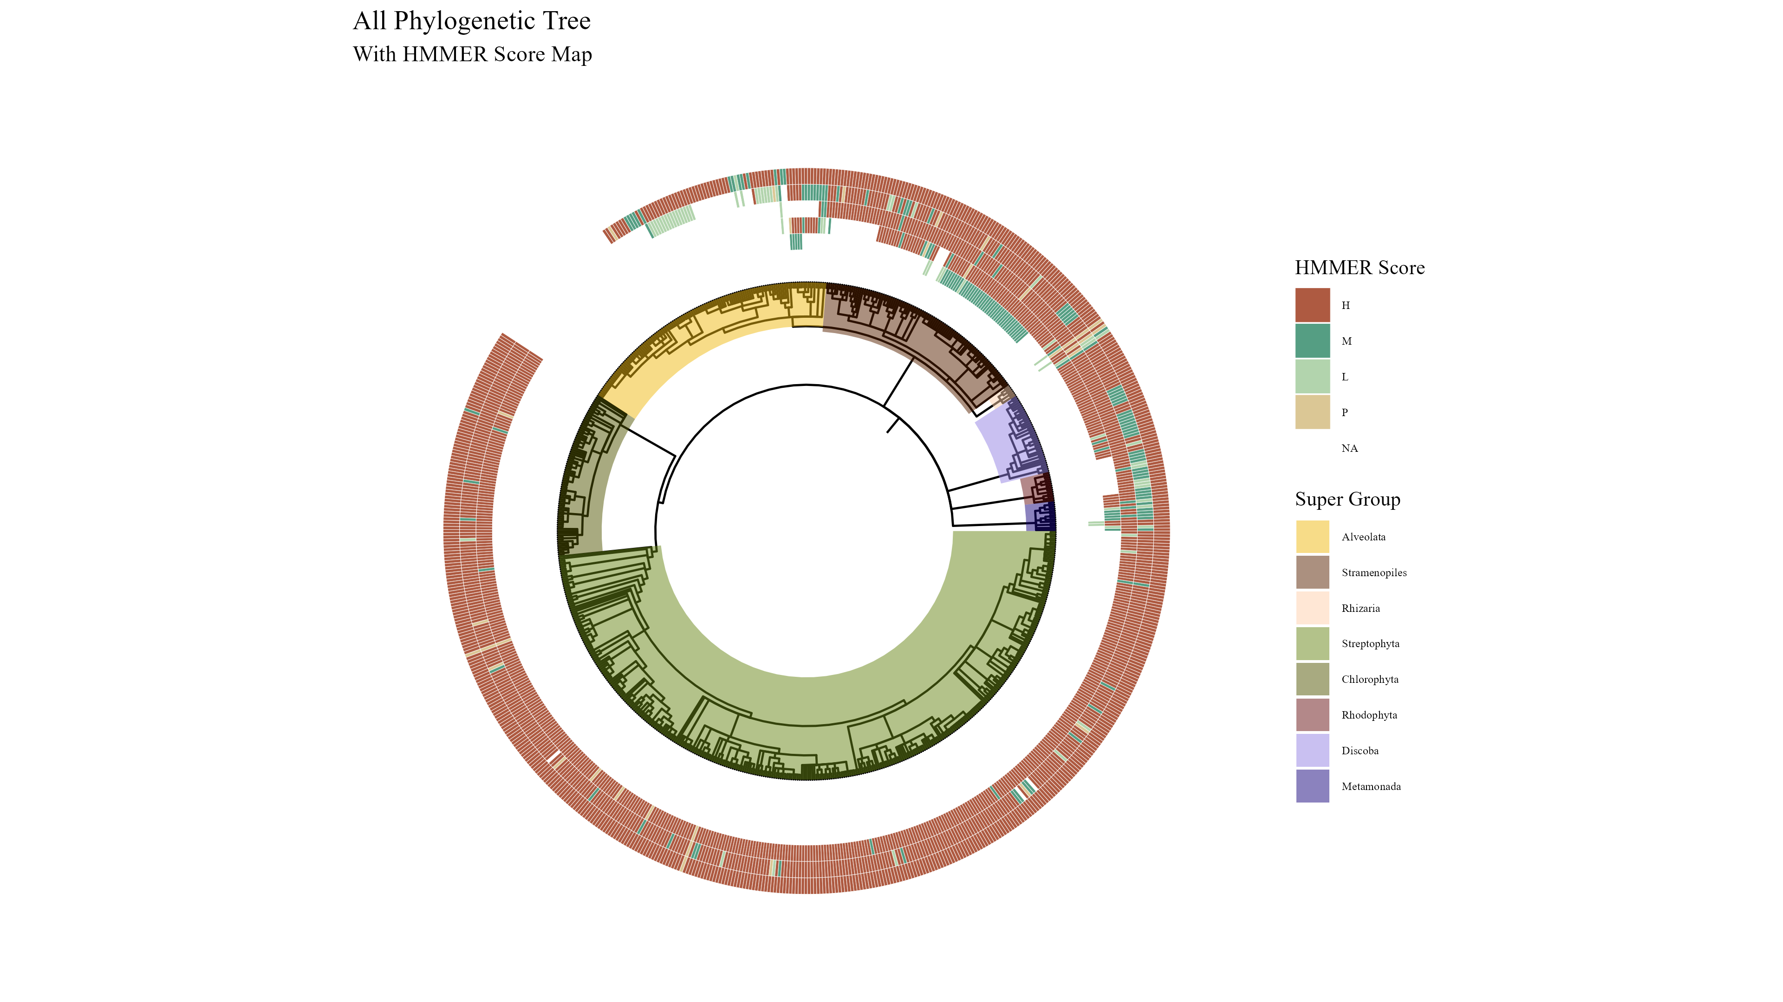
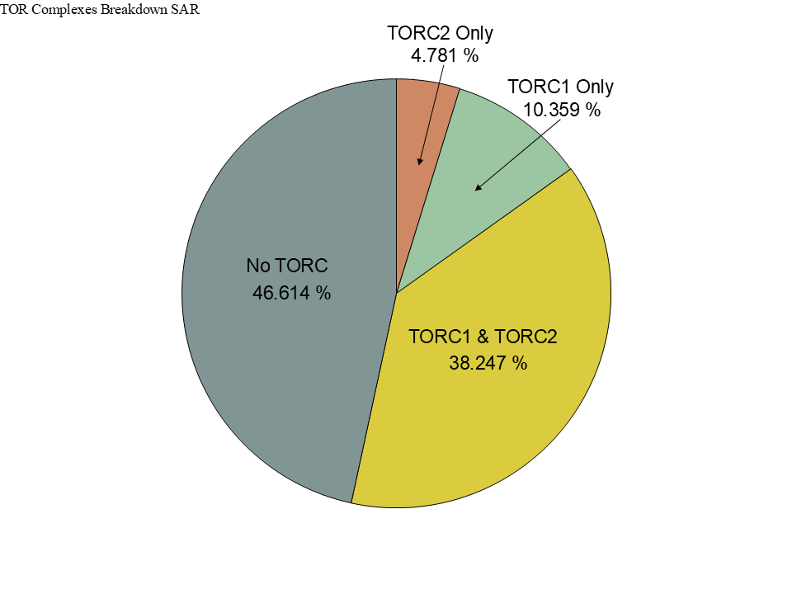
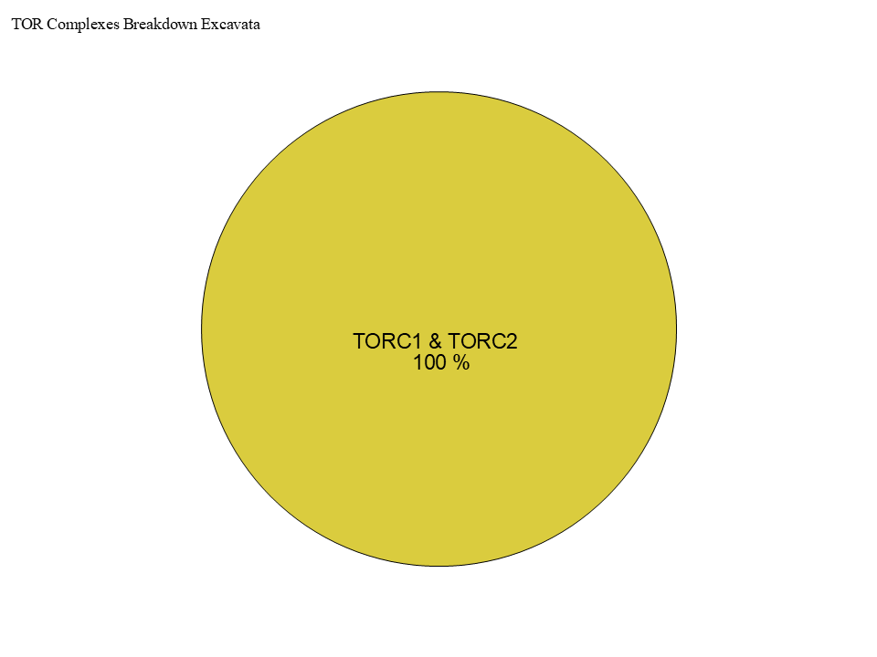
Figure 3
TOR
LST8
RAPTOR
RICTOR
SIN1

Slide 5
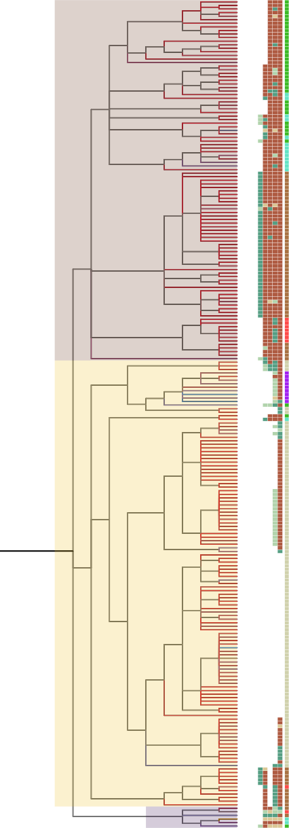
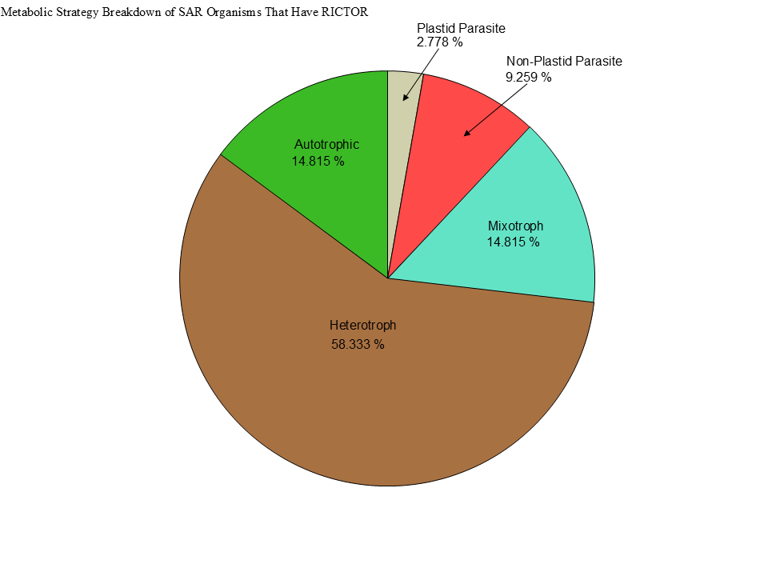
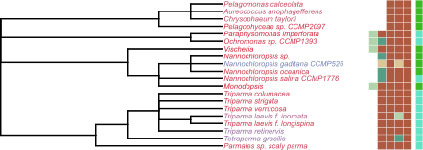
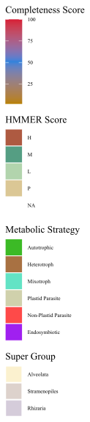
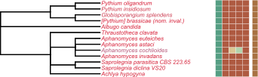
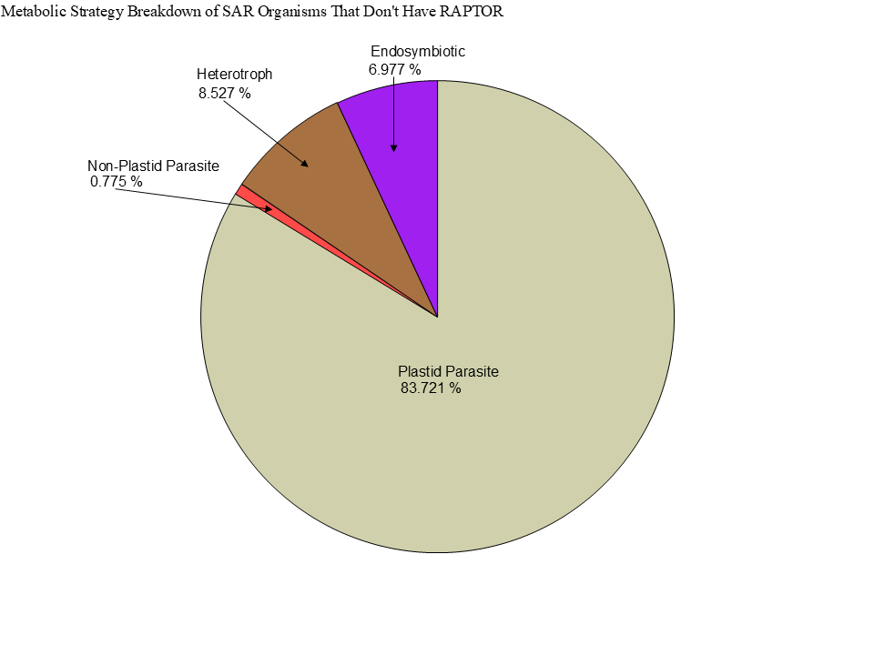
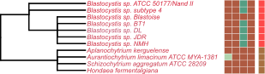
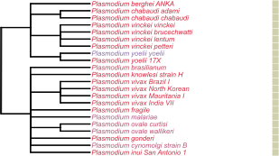
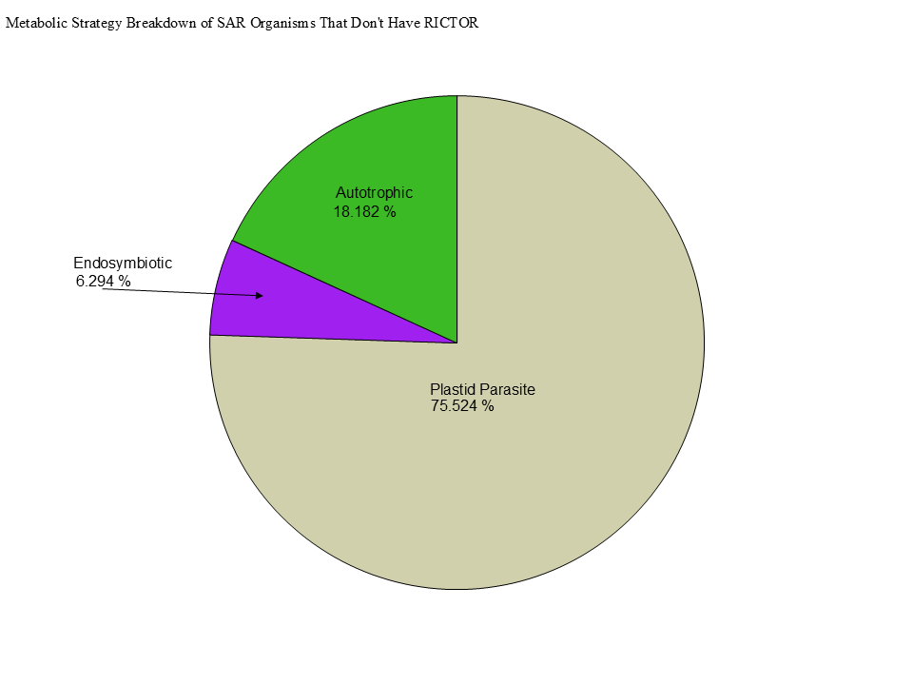
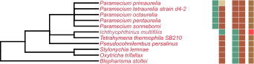
Metabolic Strategy
LST8
RICTOR
RAPTOR
SIN1
TOR
Stramenopiles
Alveolata
Rhizaria

Slide 6
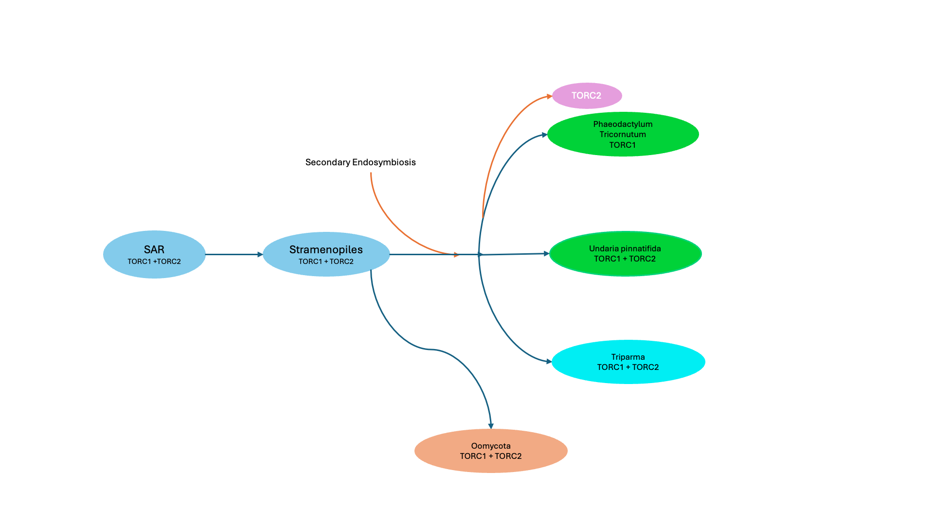

Slide 7
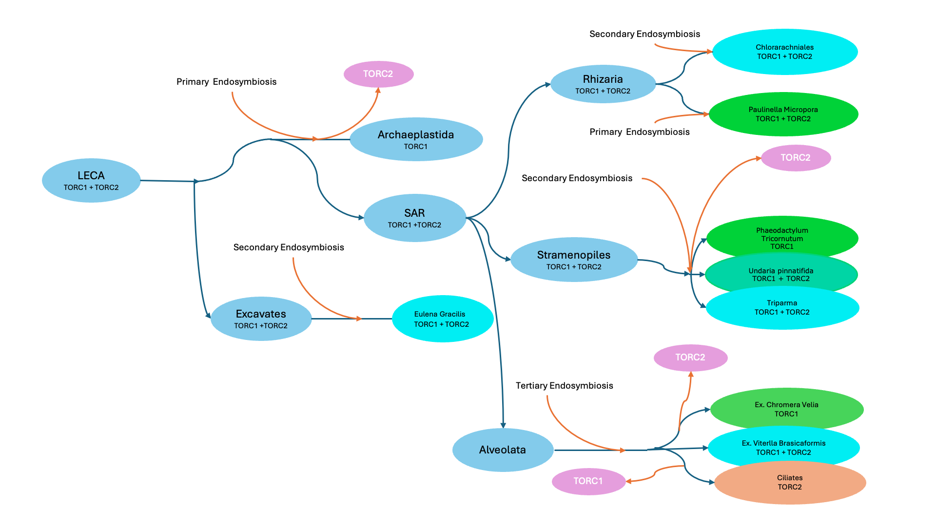


Slide 8



Figure 5

Slide 9
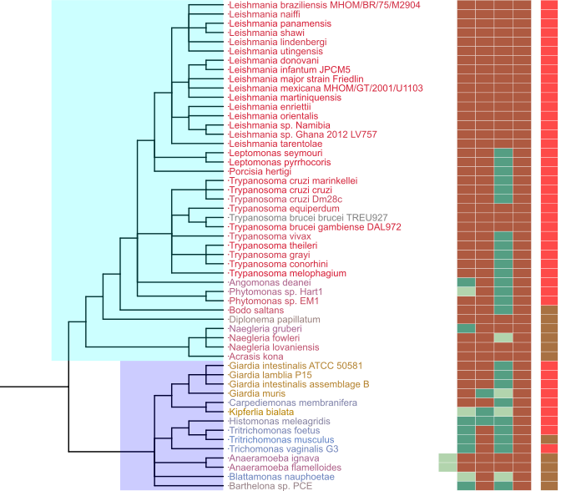
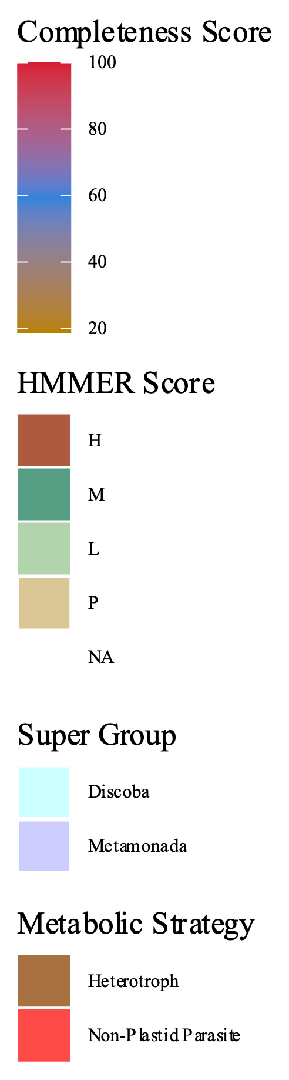
Figure 7
Metabolic Strategy
SIN1
RICTOR
RAPTOR
LST8
TOR
Discoba
Metamonada

Slide 10
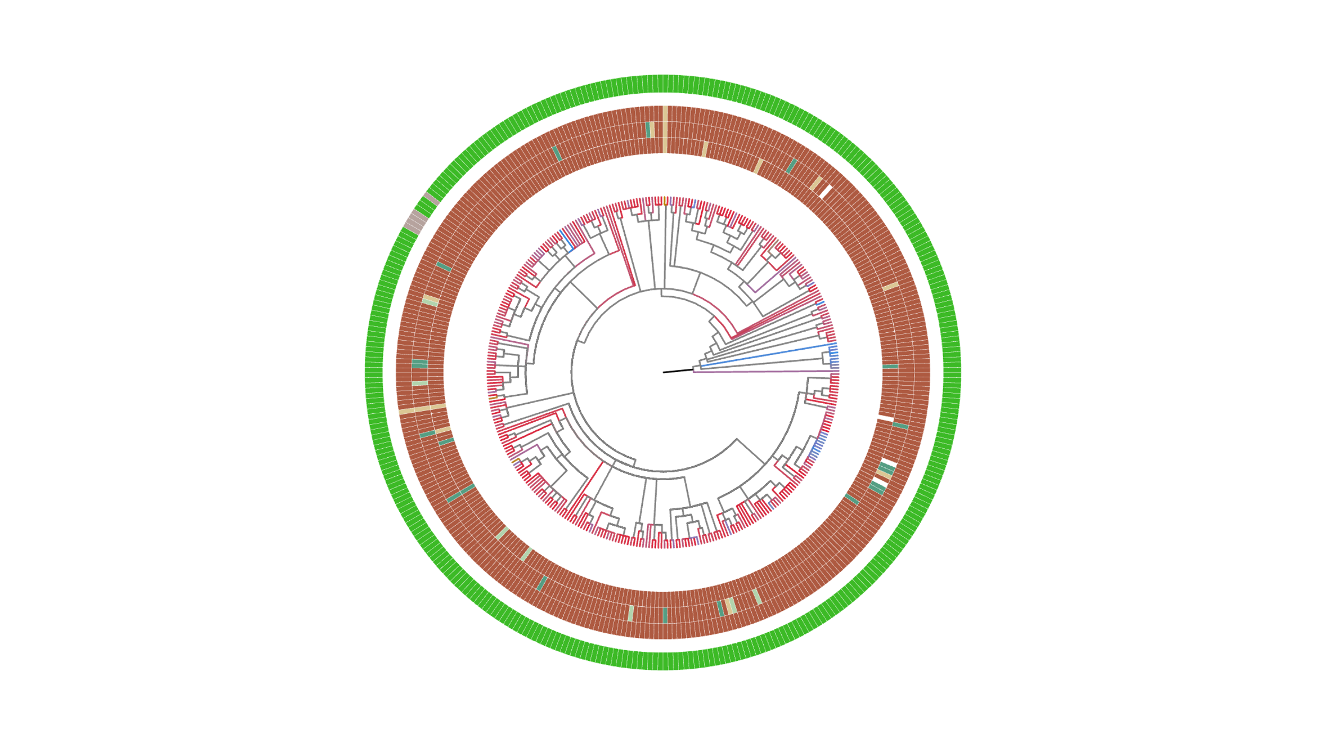
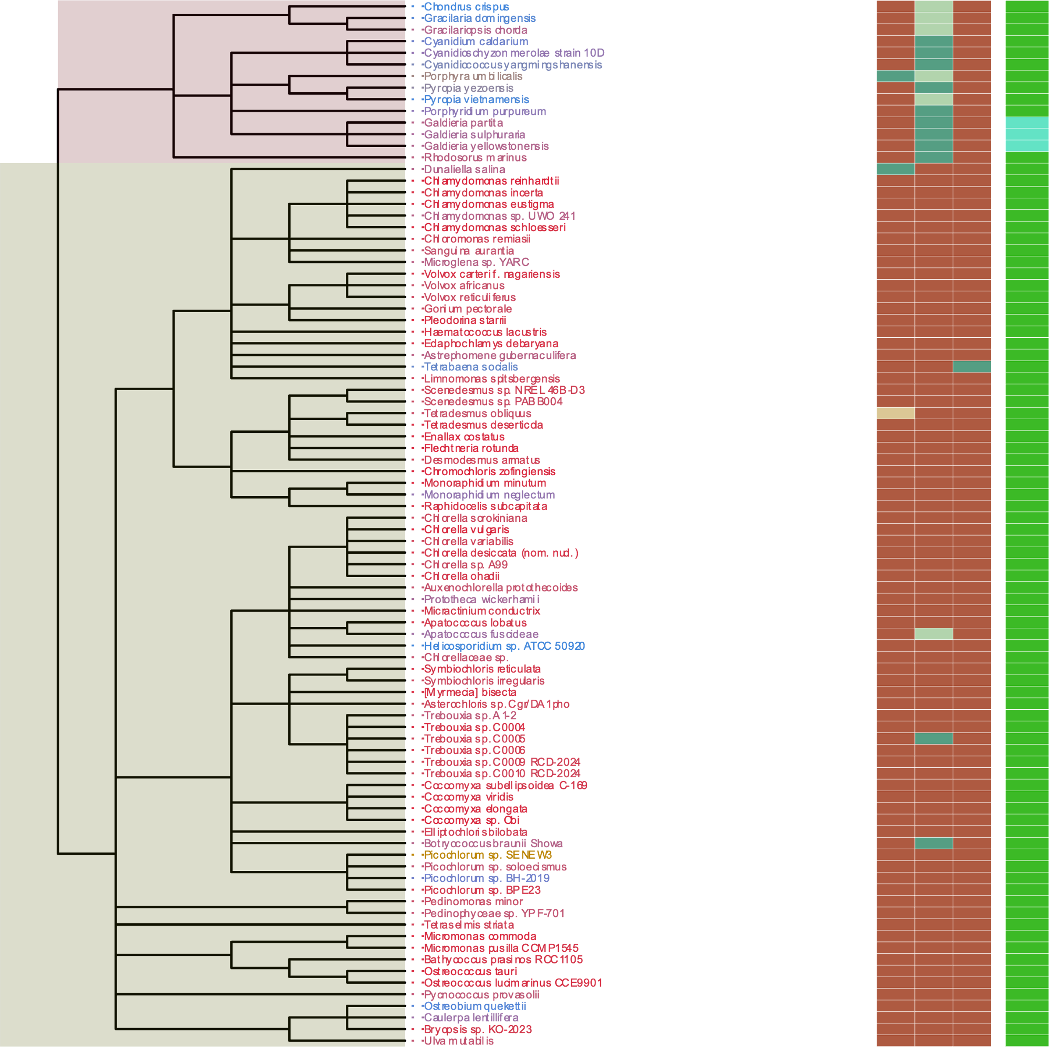
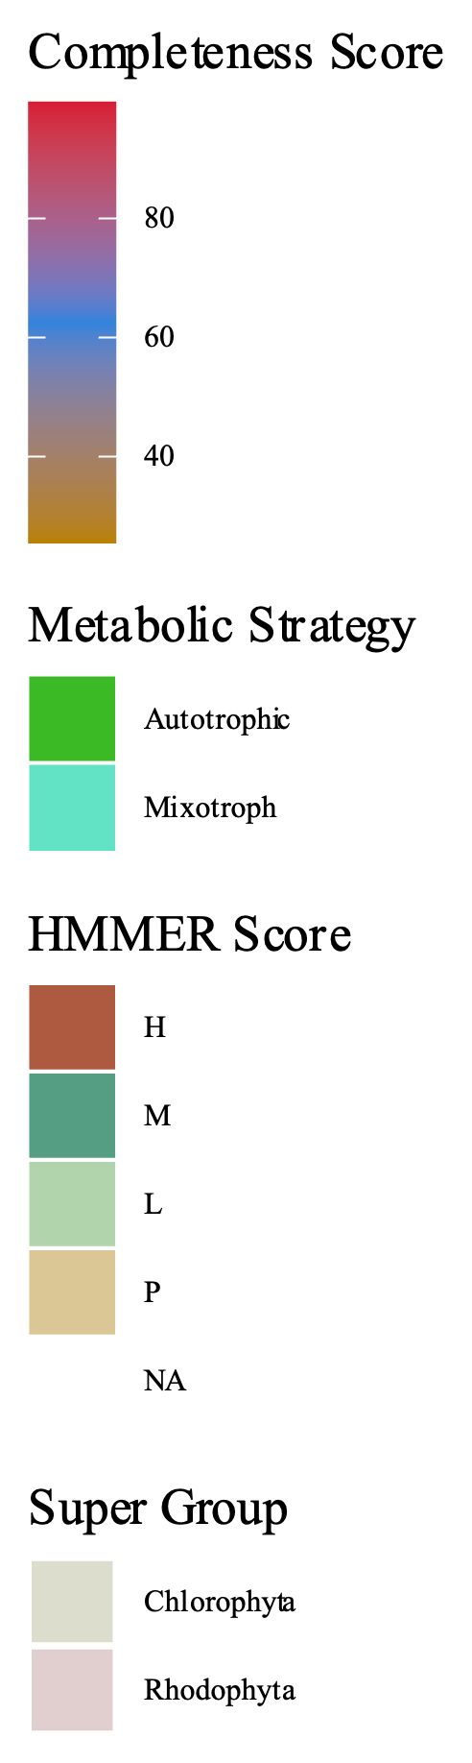
Metabolic Strategy
SIN1
RICTOR
RAPTOR
LST8
TOR
Streptophyta
Rhodophyta
Chlorophyta

Slide 11
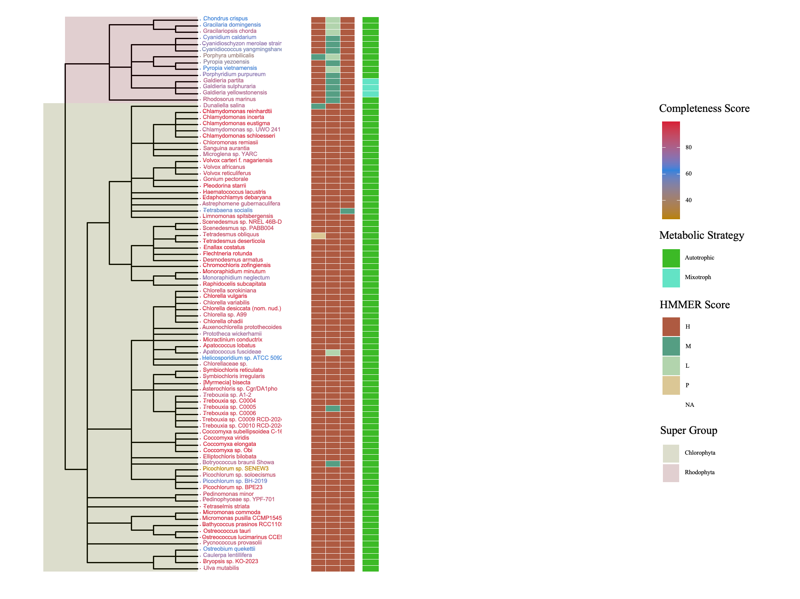
Figure 7
Metabolic Strategy
Metabolic Strategy
SIN1
RICTOR
LST8
RAPTOR
SIN1
TOR
RICTOR
RAPTOR
LST8
TOR
Rhodophyta
Discoba
Chlorophyta
Metamonada

Slide 12
ARCHIVED BELOW

Slide 13
Streptophyta
Secondary Endosymbiosis
Rhodophyta
Primary Endosymbiosis
TORC2
Chlorophyta
Chlorarachniales
TORC1 + TORC2
Rhizaria
TORC1 + TORC2
Primary Endosymbiosis
Archaeplastida
TORC1
LECA
TORC1 + TORC2
Paulinella Micropora
TORC1 + TORC2
SAR
TORC1 +TORC2
Secondary Endosymbiosis
TORC2
Stramenopiles TORC1 + TORC2
Brown Algae
TORC1
Secondary Endosymbiosis
Excavates
TORC1 +TORC2
Tertiary Endosymbiosis
TORC2 + TORC1
Eulena Gracilis
TORC1 + TORC2
Alveolata

Slide 14
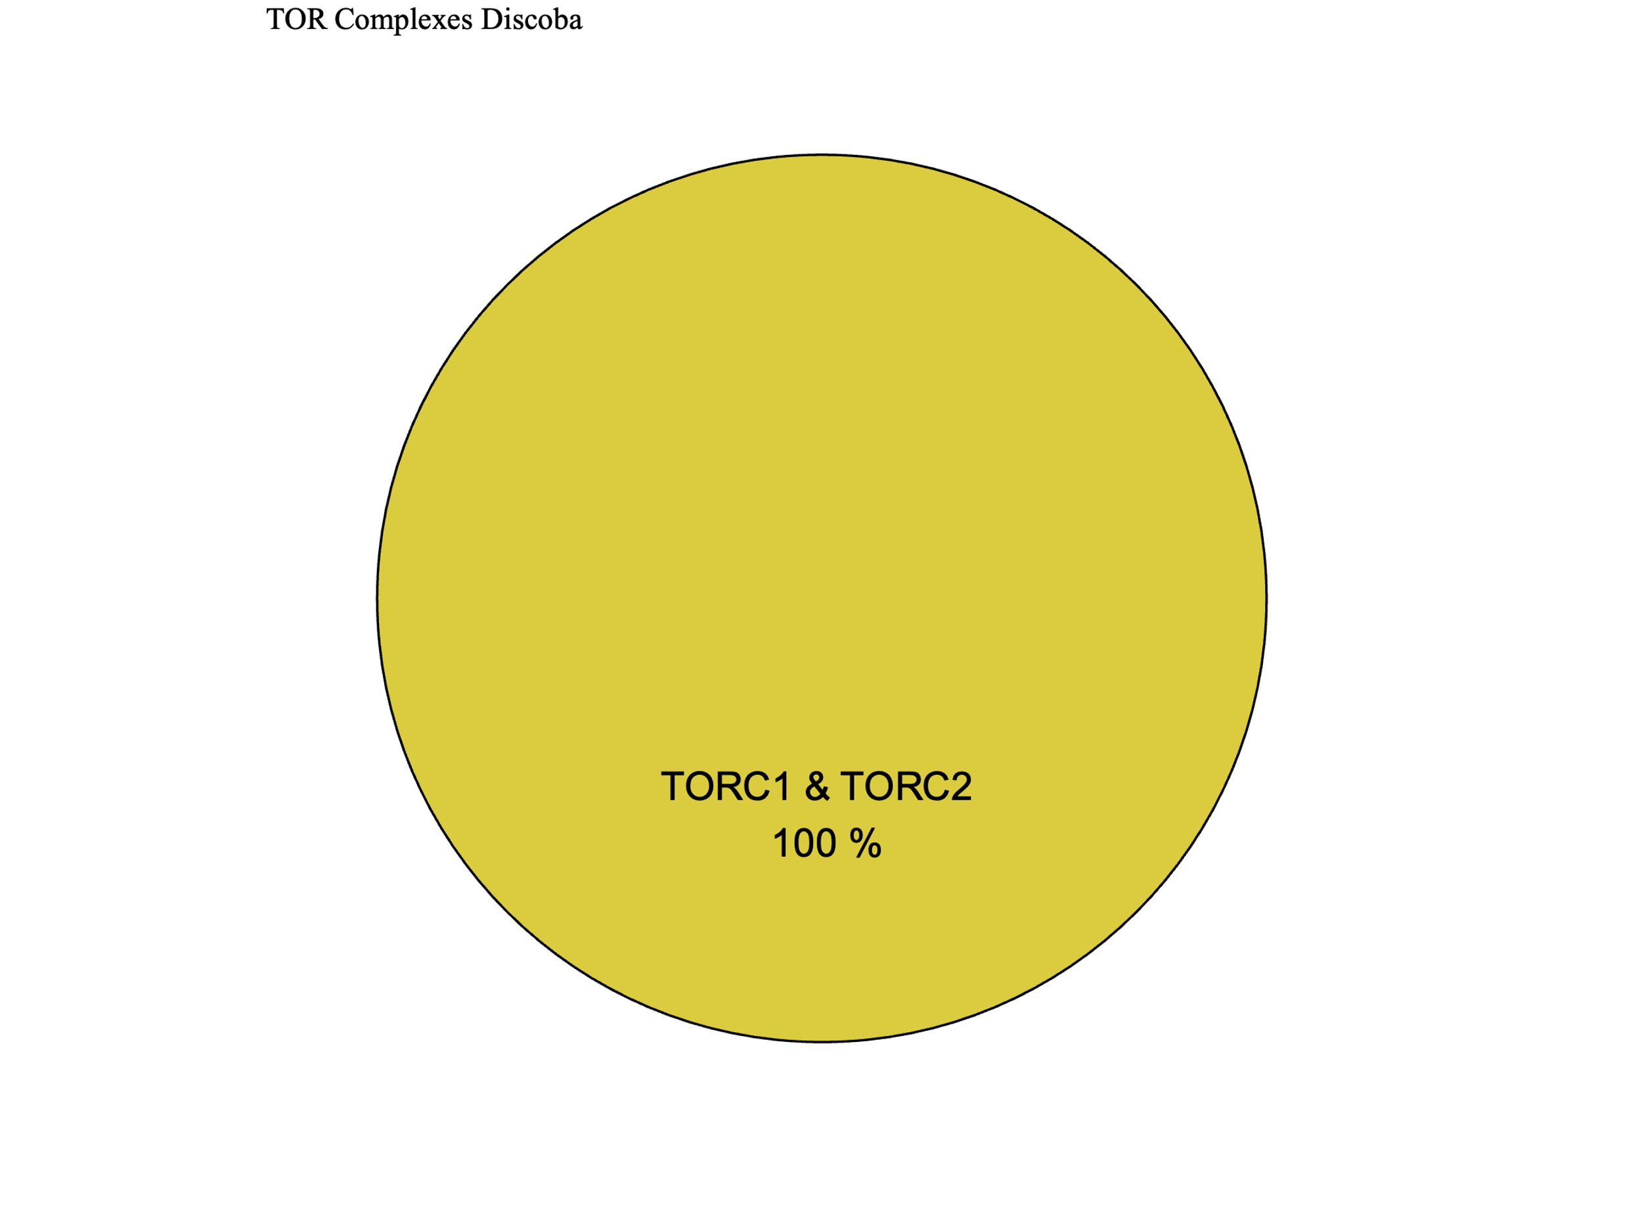
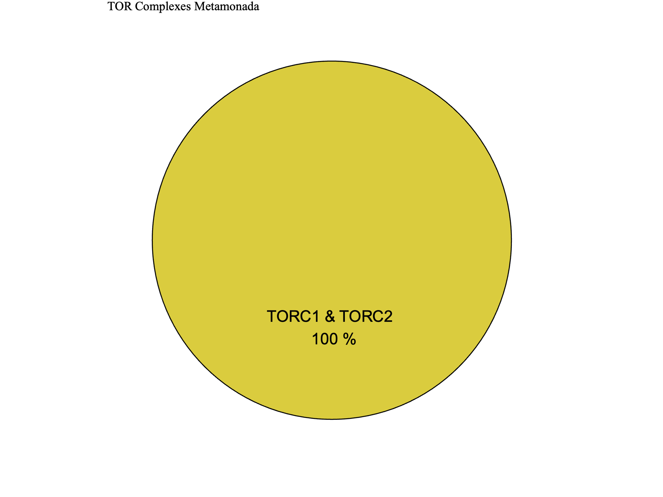
Figure 7
Metabolic Strategy
SIN1
RICTOR
RAPTOR
LST8
TOR
Discoba
Metamonada

Slide 15
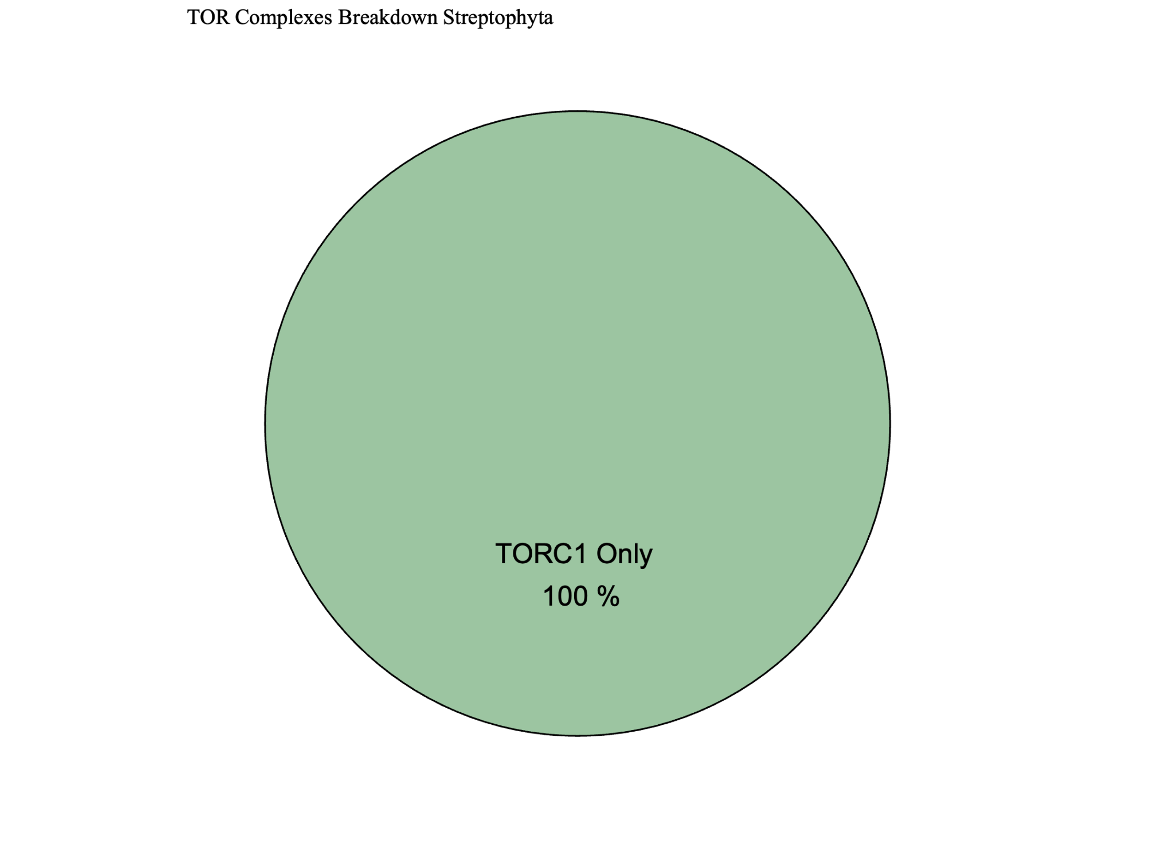
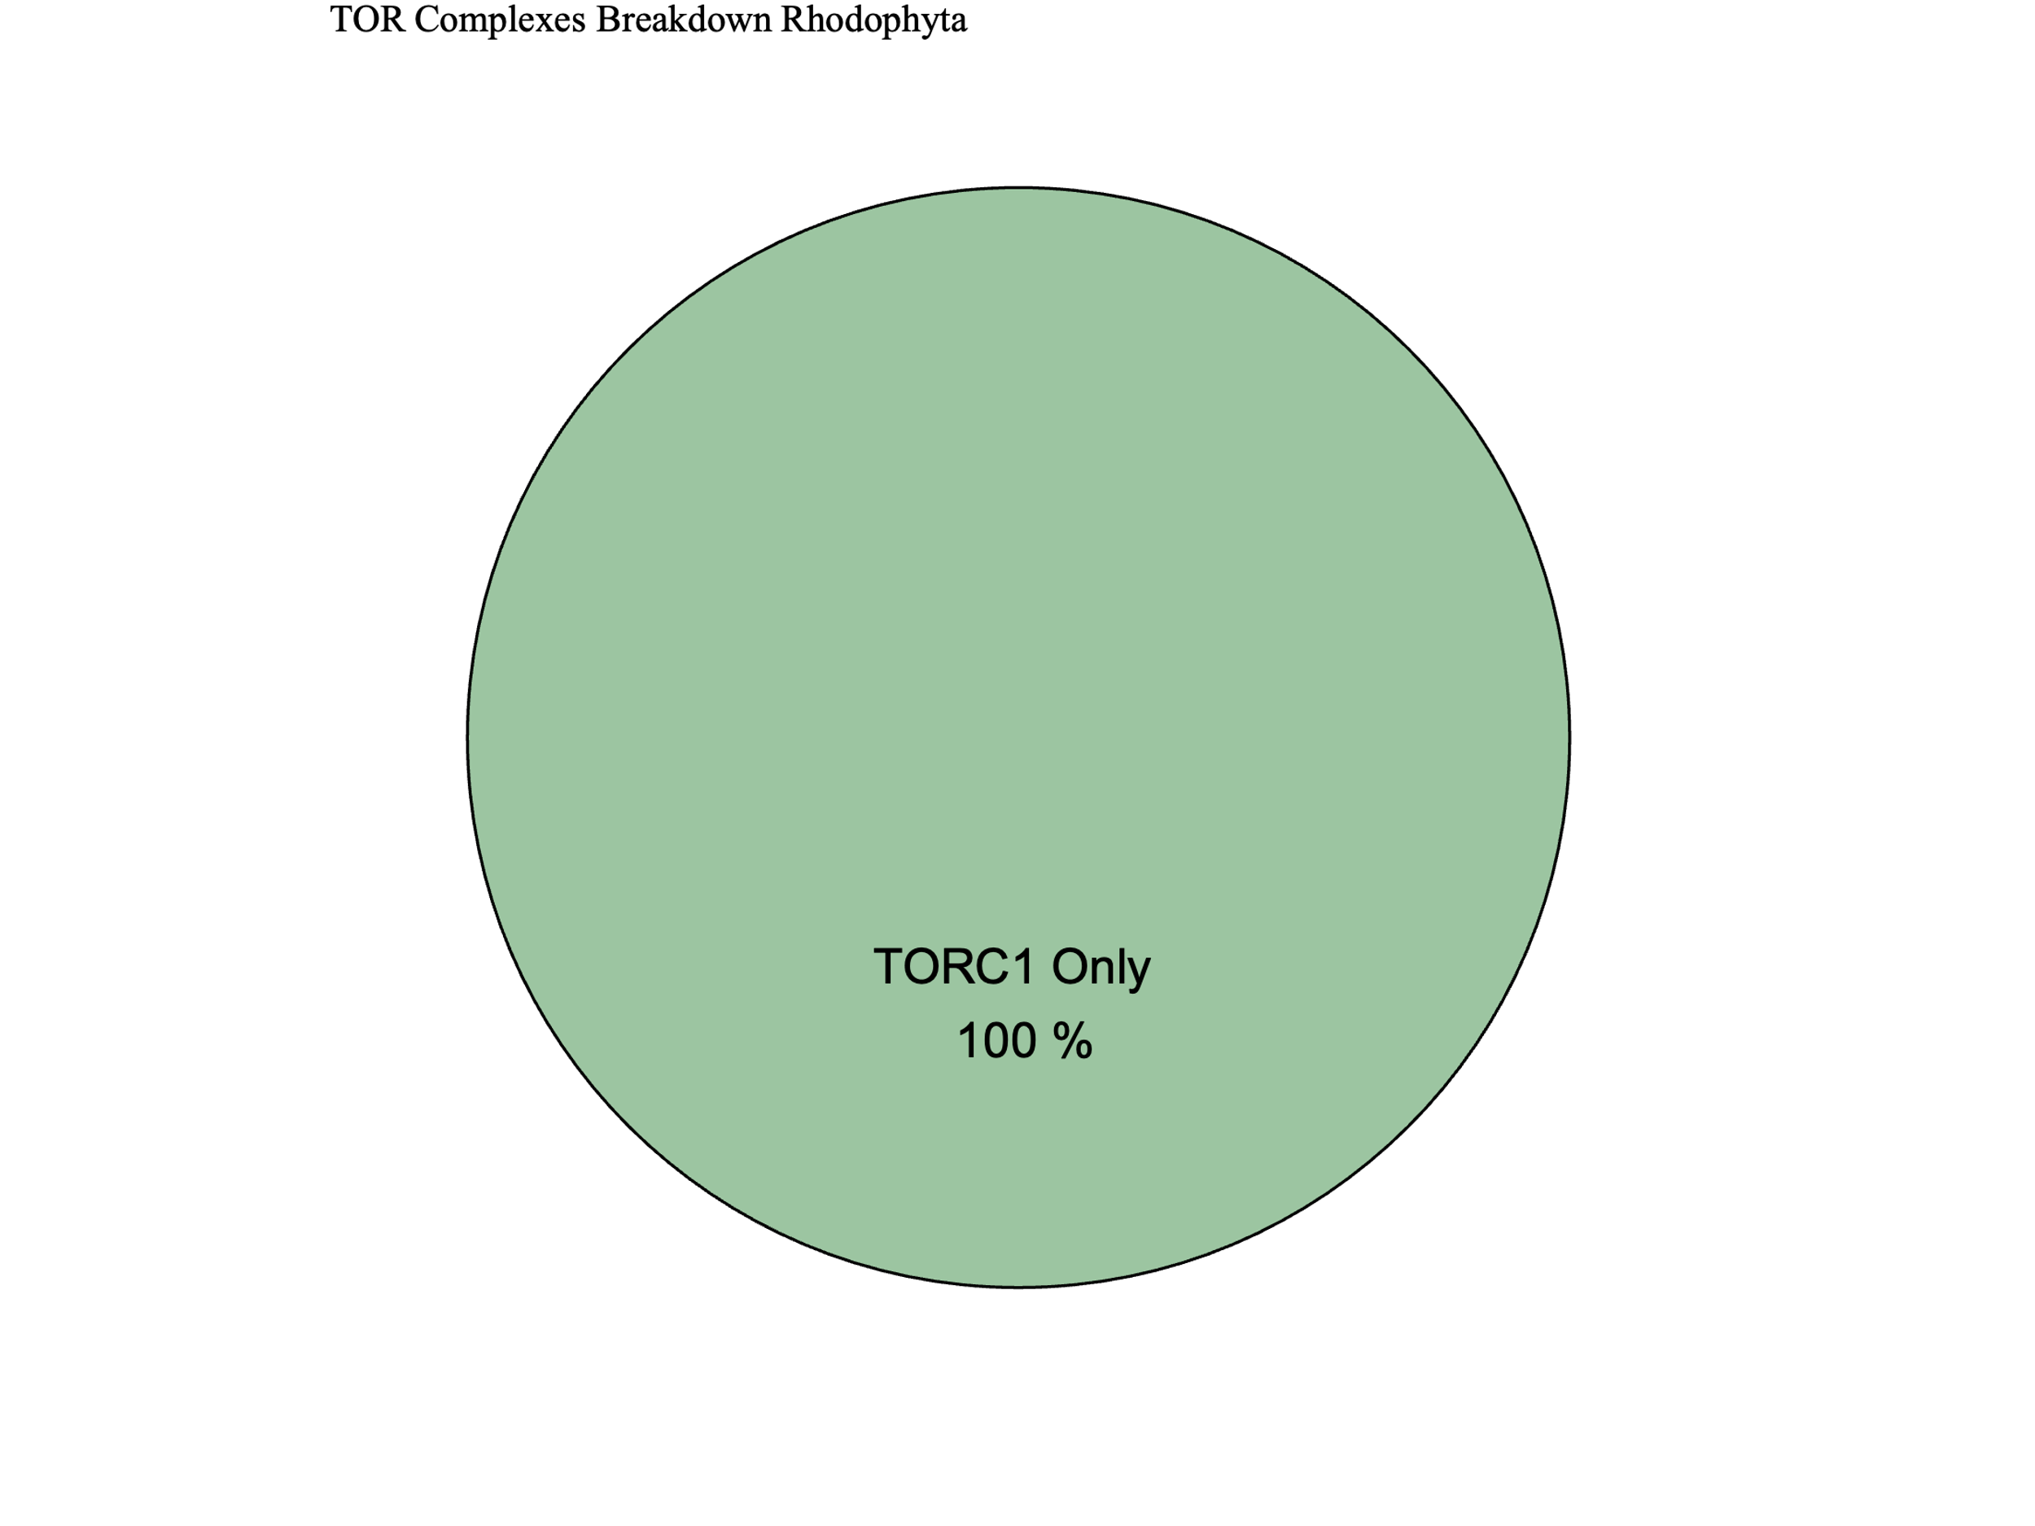
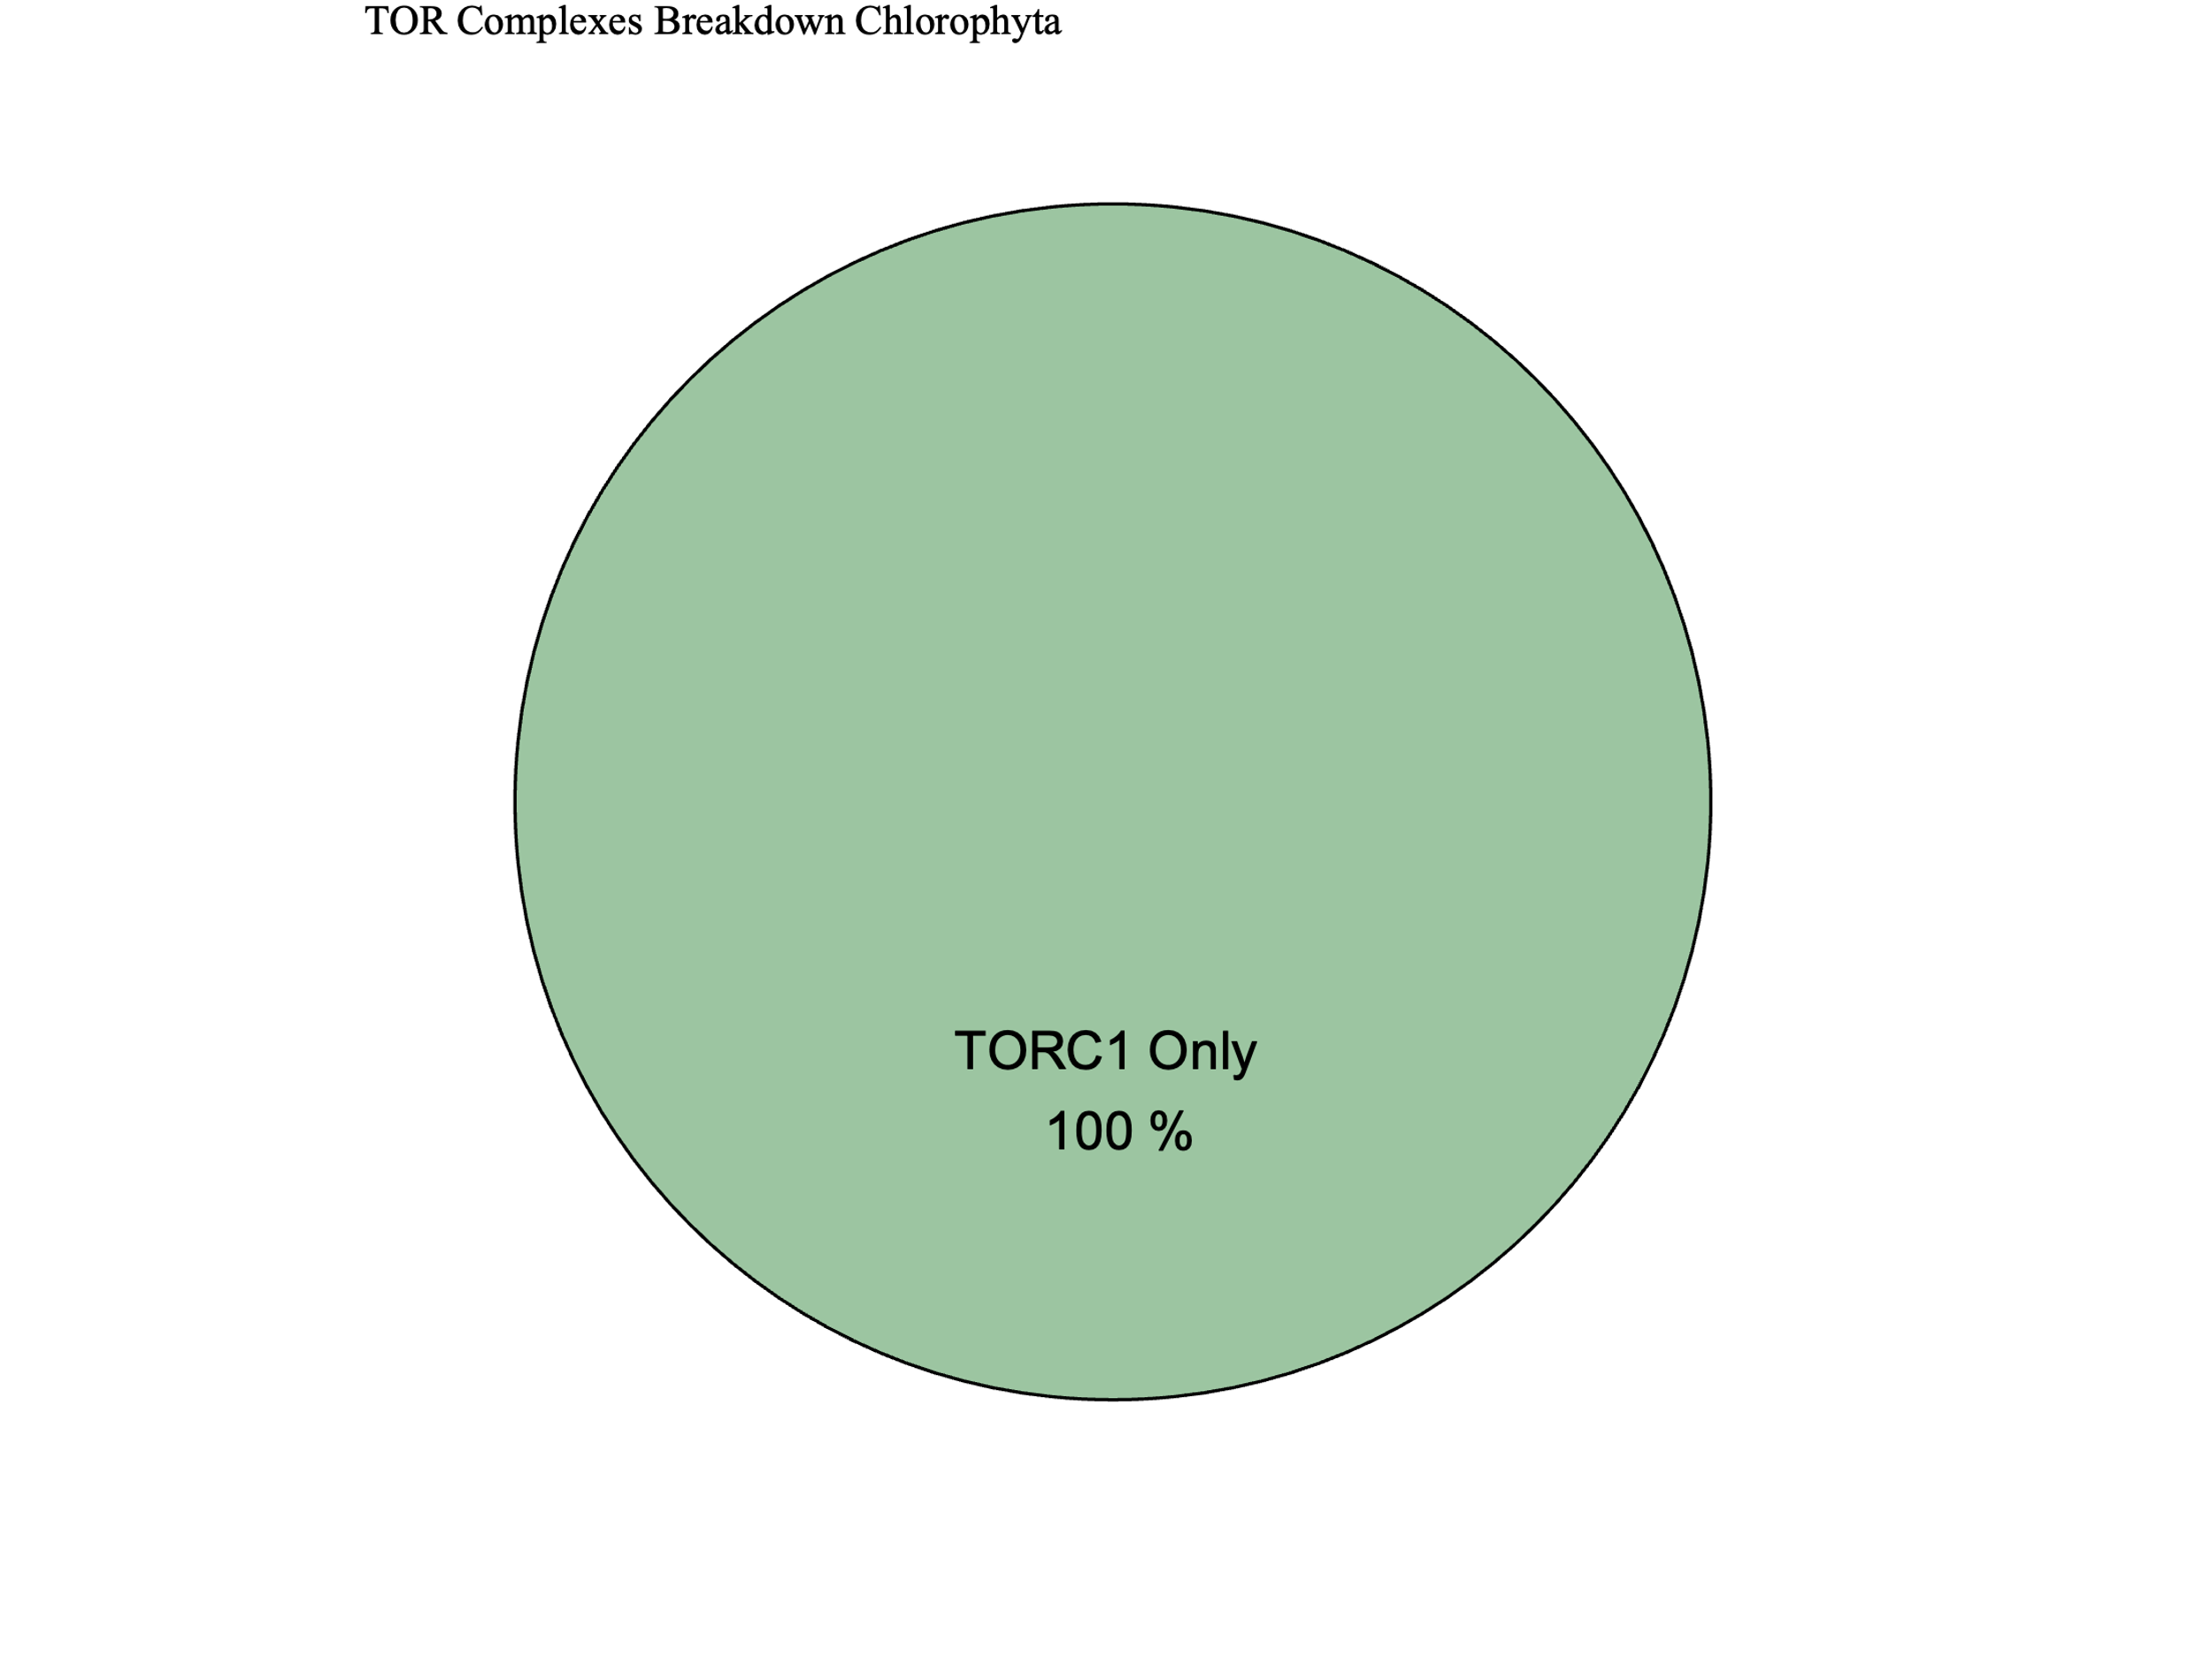
Metabolic Strategy
Streptophyta
SIN1
RICTOR
RAPTOR
LST8
TOR
Rhodophyta
Chlorophyta

Slide 16



Slide 17





Figure 6

Slide 18
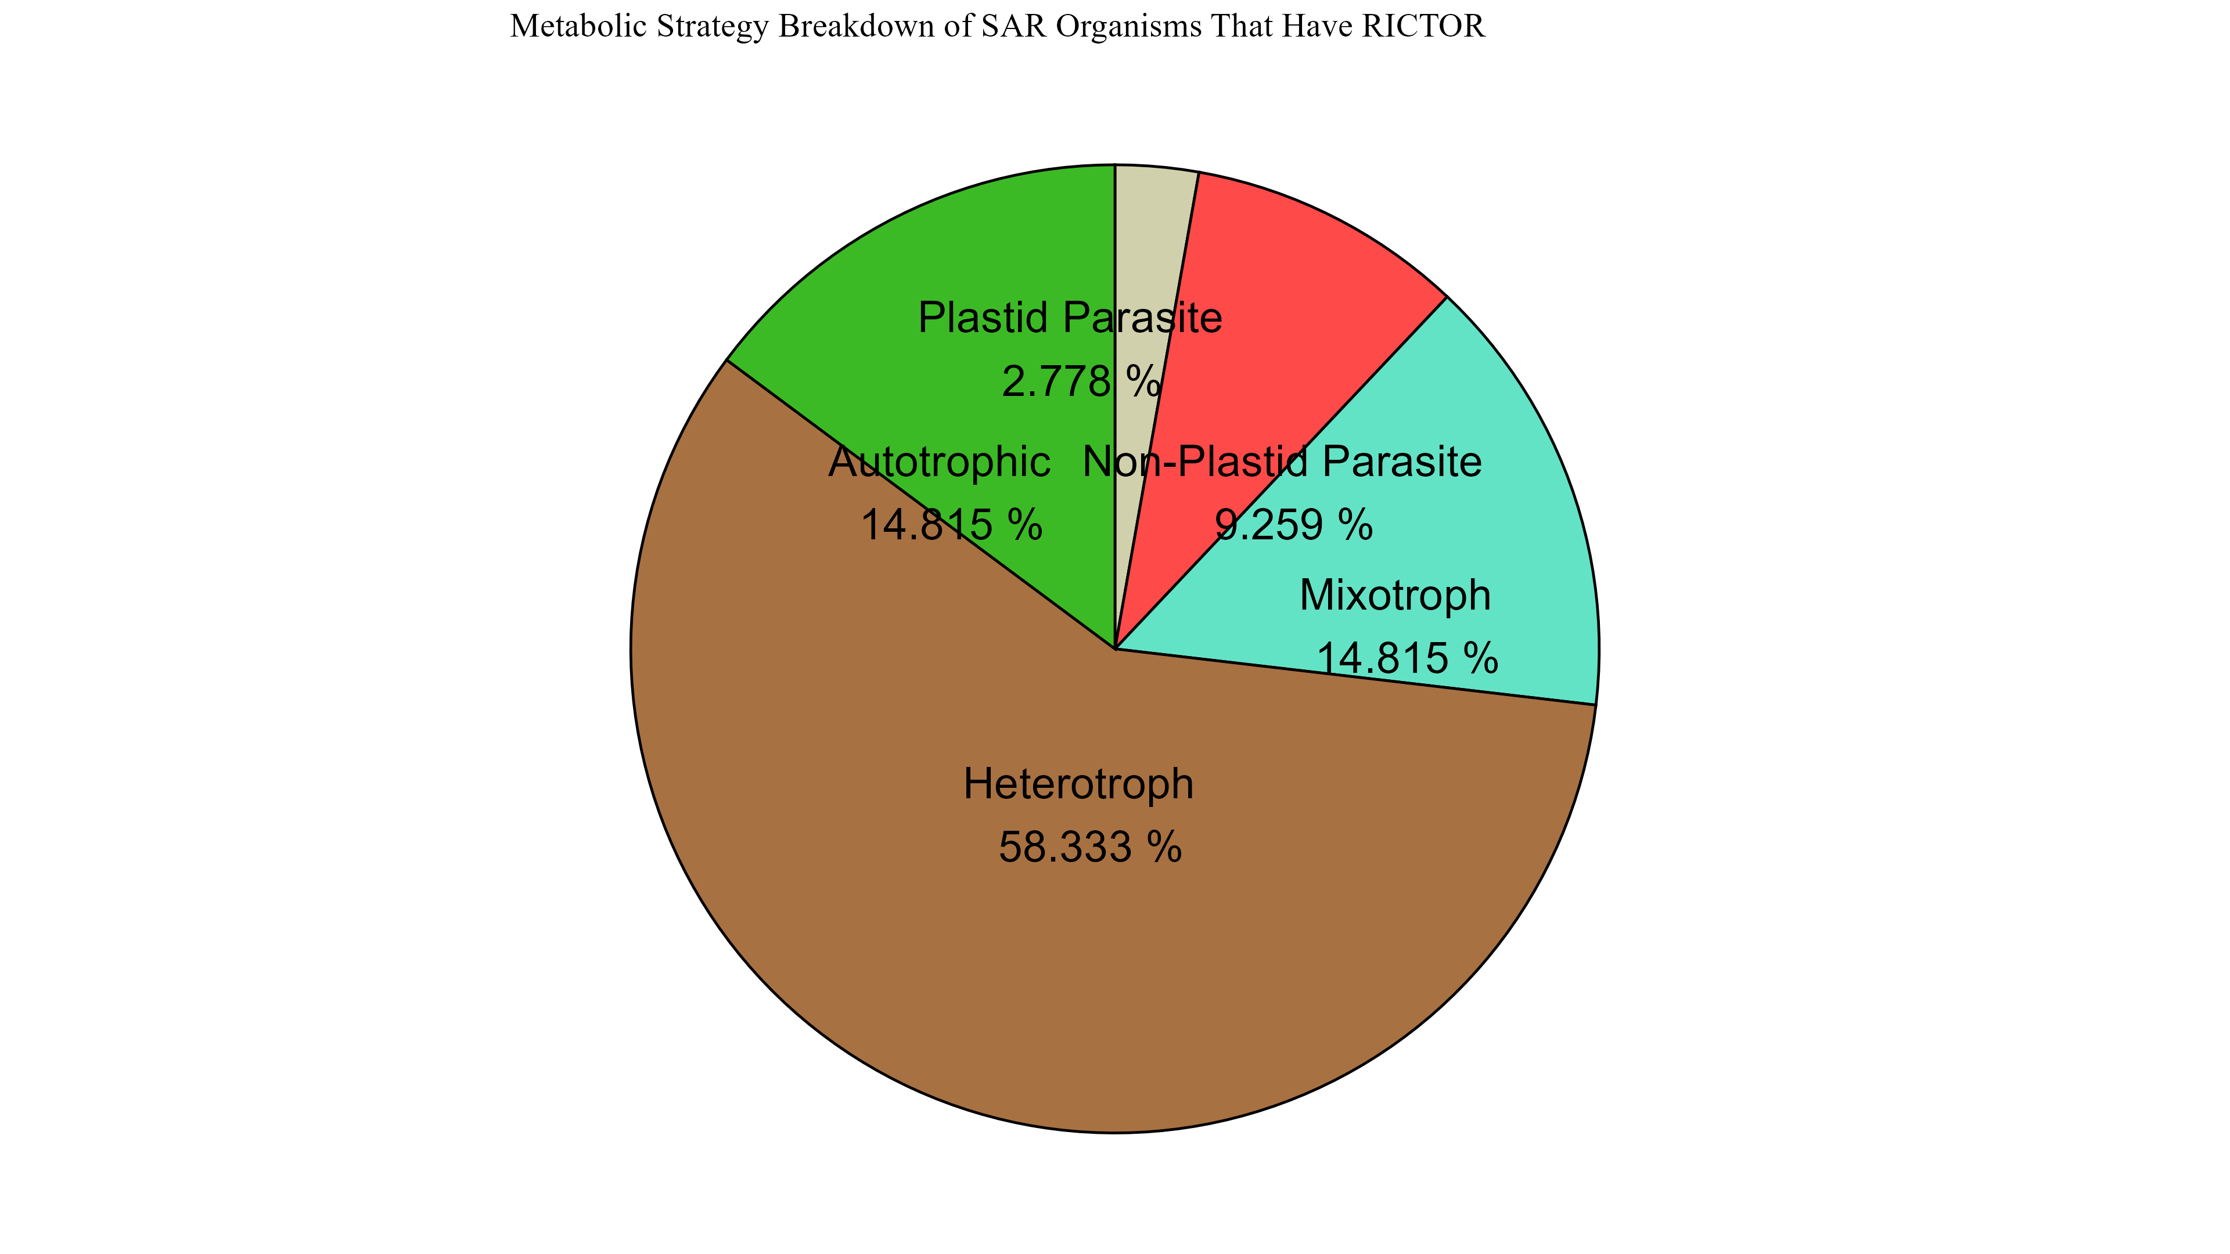
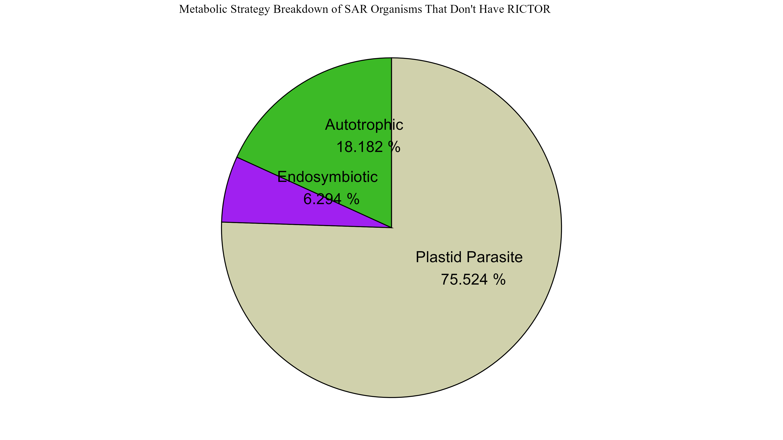
Figure 6

Slide 19
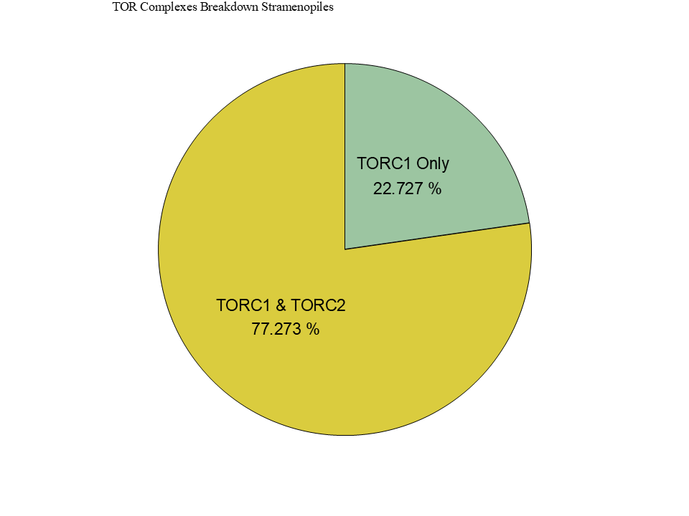
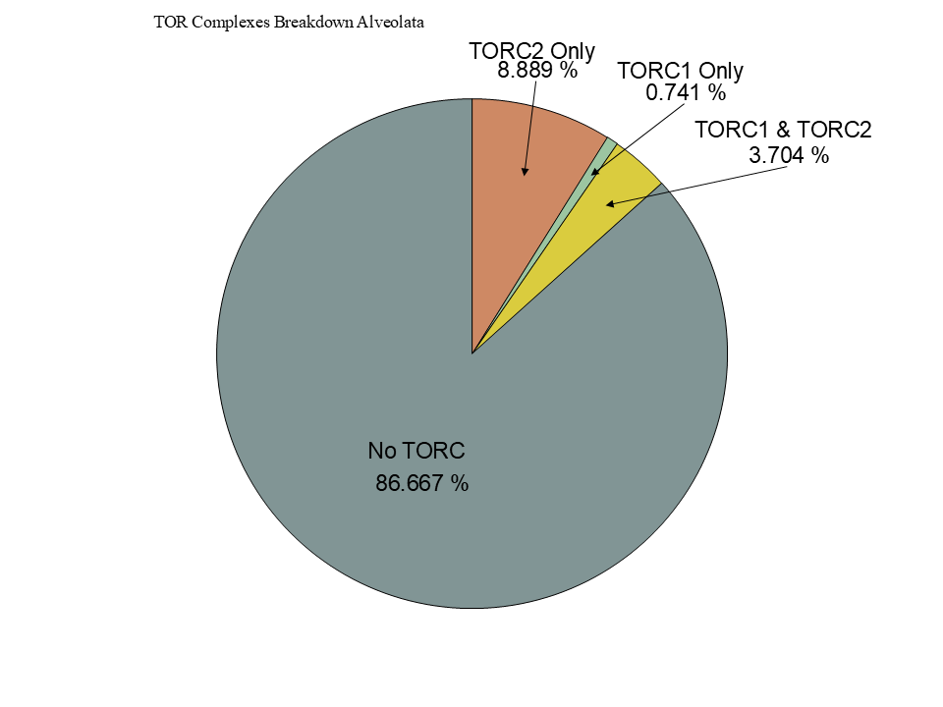
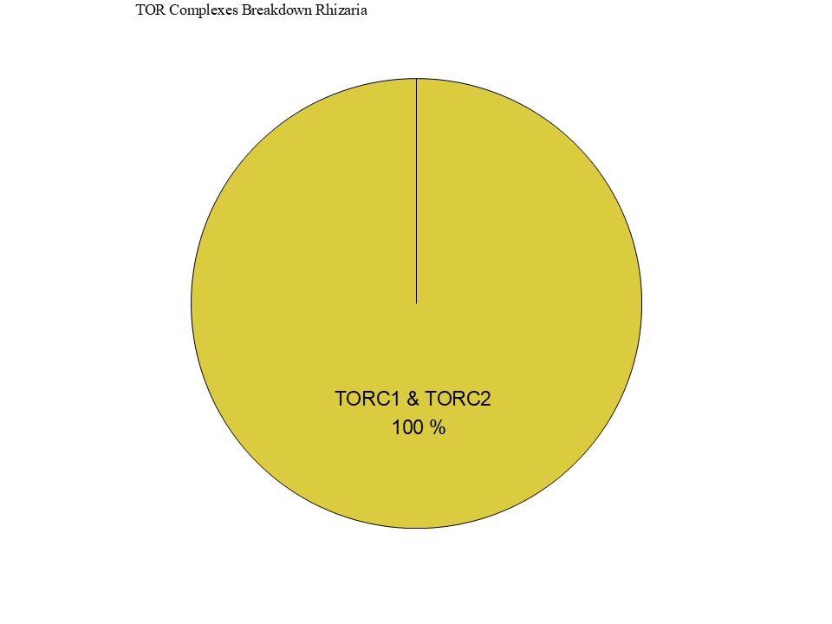
Figure 6

Slide 20
Figure 5

Slide 21
Workflow/Pipeline
NCBI/JGI Genomic Information
MSA
Phylogenetic Tree(s)
Results/TOR Complex Patterns
BUSCO/HMMER/BLAST
R Tables & Taxonomy Tables
Graphs/Data Table
SRA /Diamond Alignment
Notes:
We need to add a start point. Have something that asks the question; what organisms have TORC2 Components and TORC1 Components?

Slide 22
SARs Gain of Plastids:
Losses of TOR Complexes
Rhodophyta Endosymbiosis
Phaeodactylum tricornutum
TORC2 Lost
Macrocystis pyrifera
Stramenopila
Nannochloropsis gaditana
Phytophthora sojae
Expected Heterotrophic Ancestor
TORC1 & TORC2 Present
Stramenopile Endosymbiosis
Polarella glaciallis
Vitrella Brassicaformis
Alveolata
Plasmodium falciparum
Tetrahymena thermophila
Alpha-Cyanobacteria Endosymbiosis
Photoautorophy Loss
Paulinella micropora
TORC1 and TORC2 Lost
Bigelowiella natans
TORC1 Lost
Rhizaria
Chlorophyta Endosymbiosis
Plasmodiophora brassicae

Slide 23
Figure 4

Slide 24
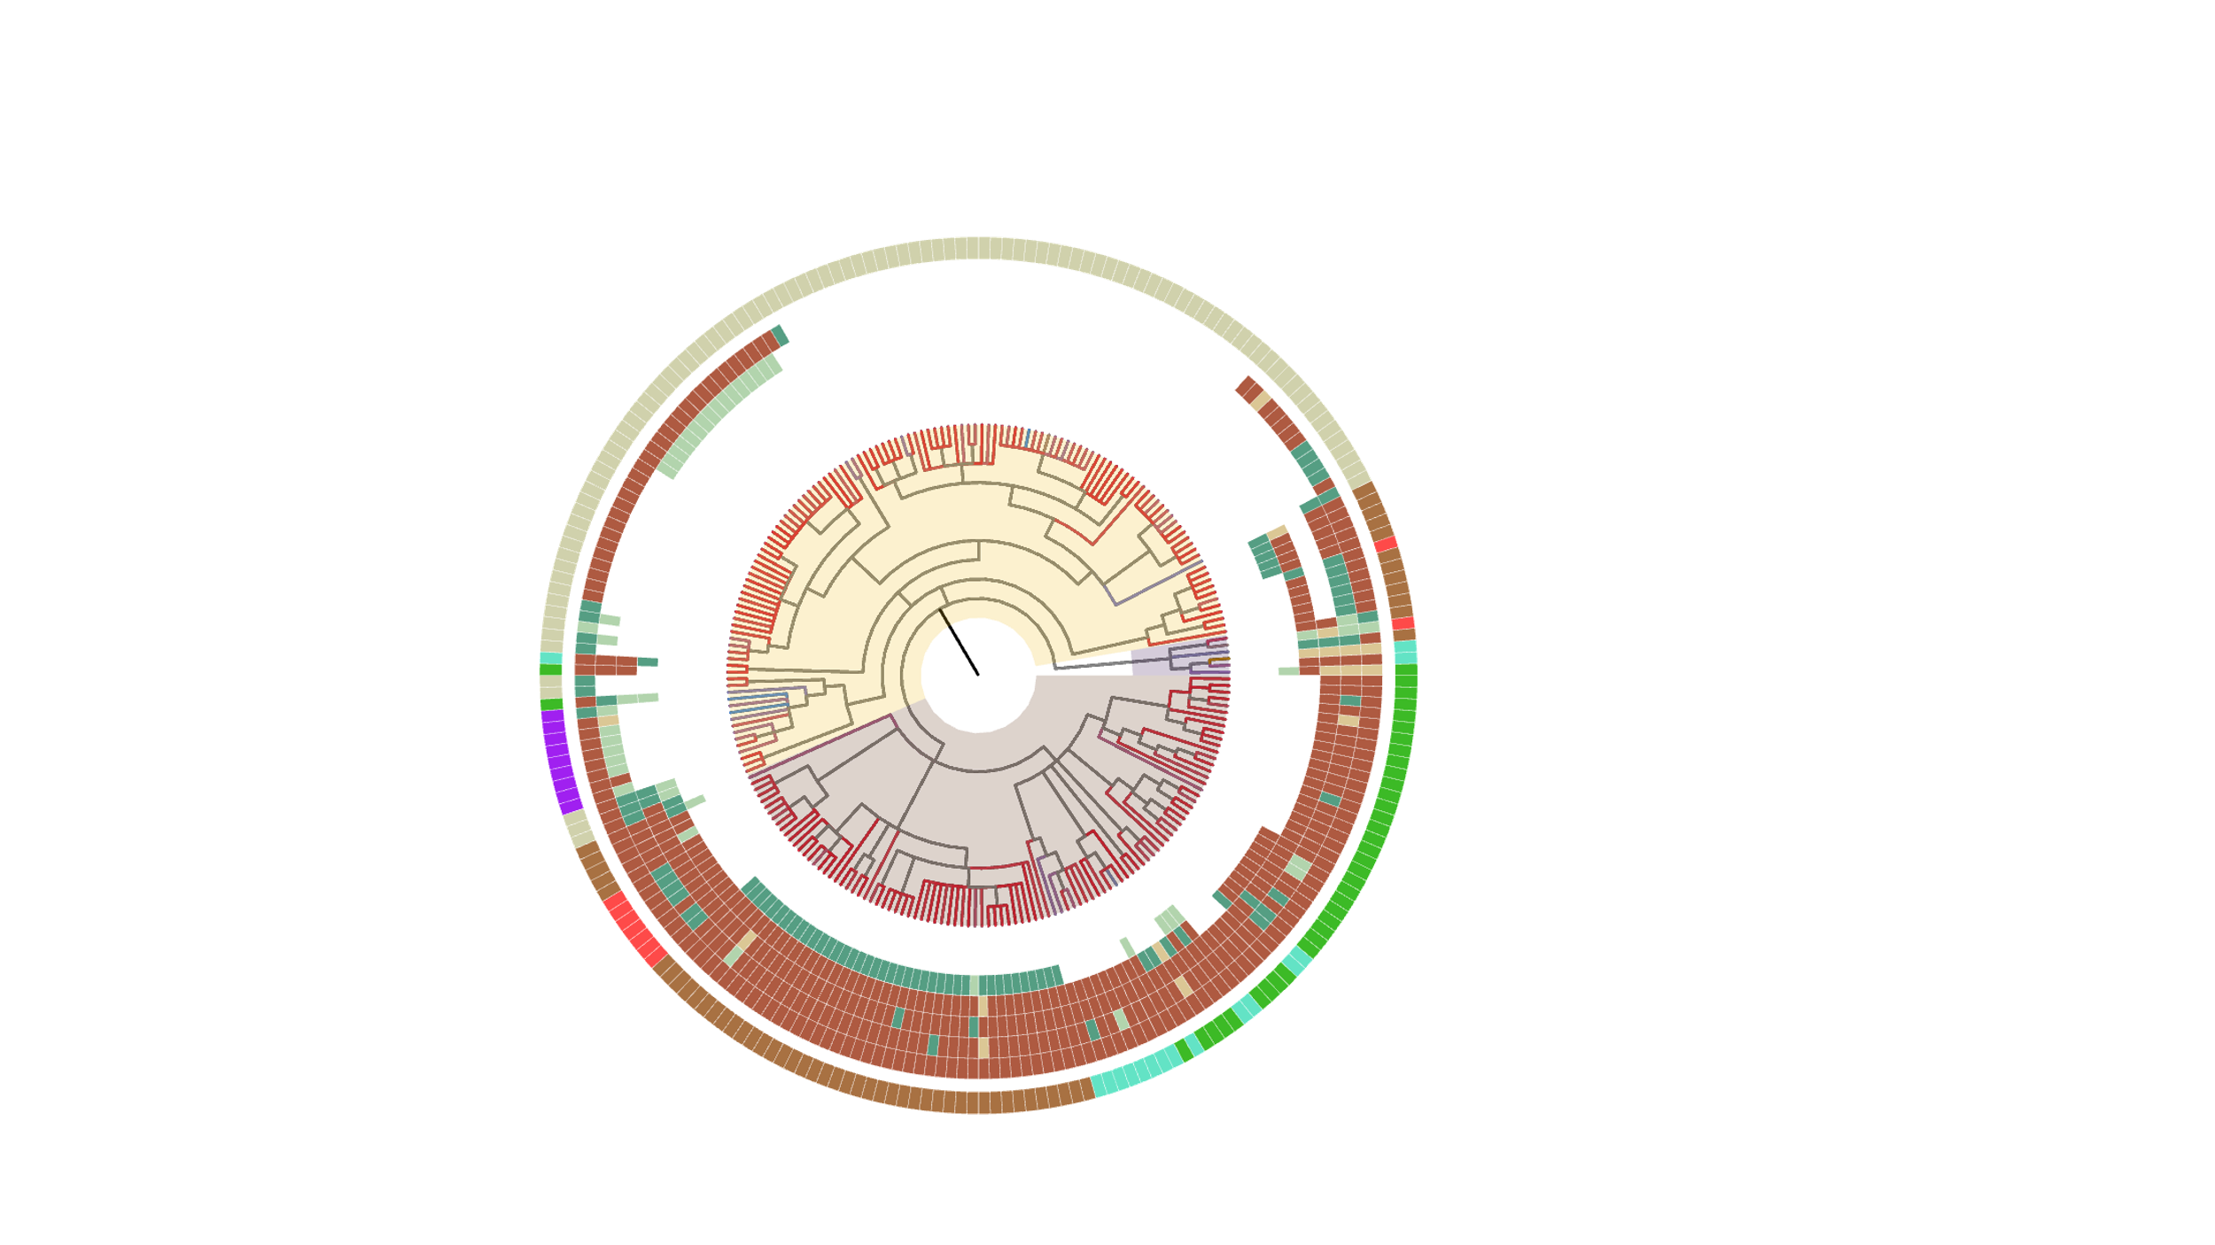

Slide 25
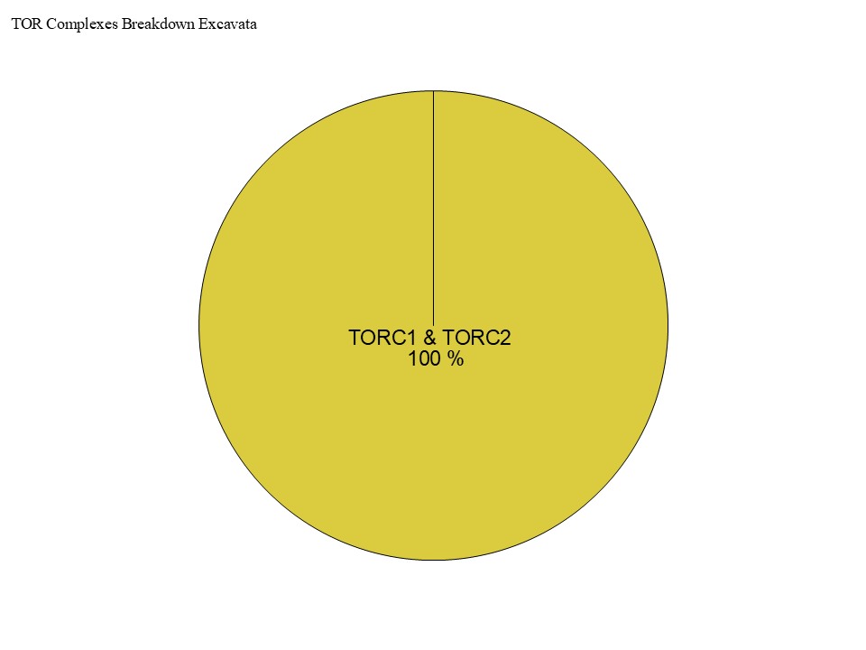
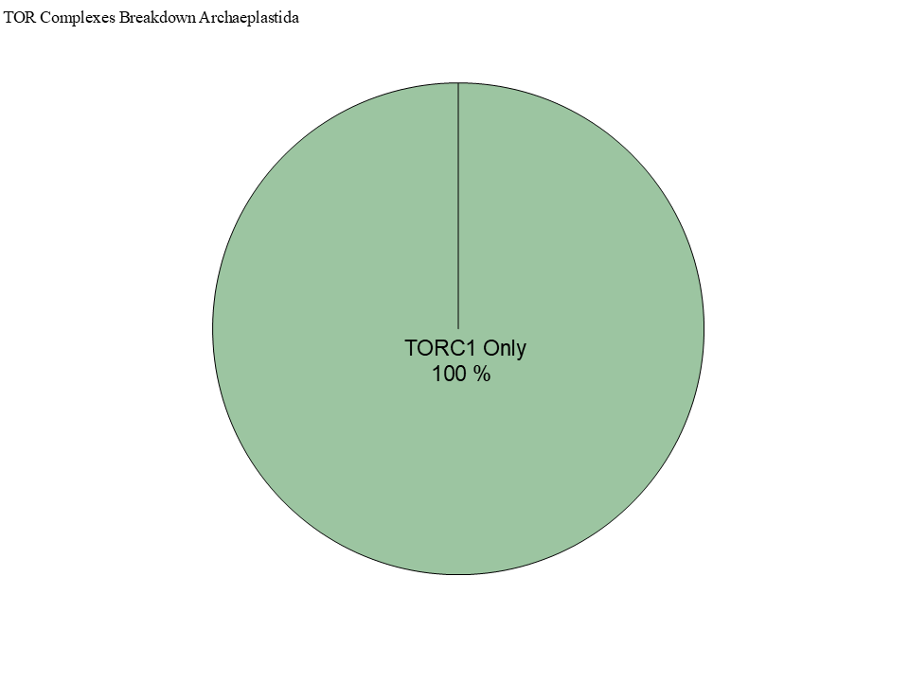
Figure 4

Slide 26
Simplified Excavata Gain of Plastids
Chlorophyta Endosymbiosis
Euglenophyceae
Discoba
Kinetoplastea
Eutetramitia, etc.
Expected Heterotrophic Ancestor
TORC1 & TORC2 Present
Metamonada

Slide 27
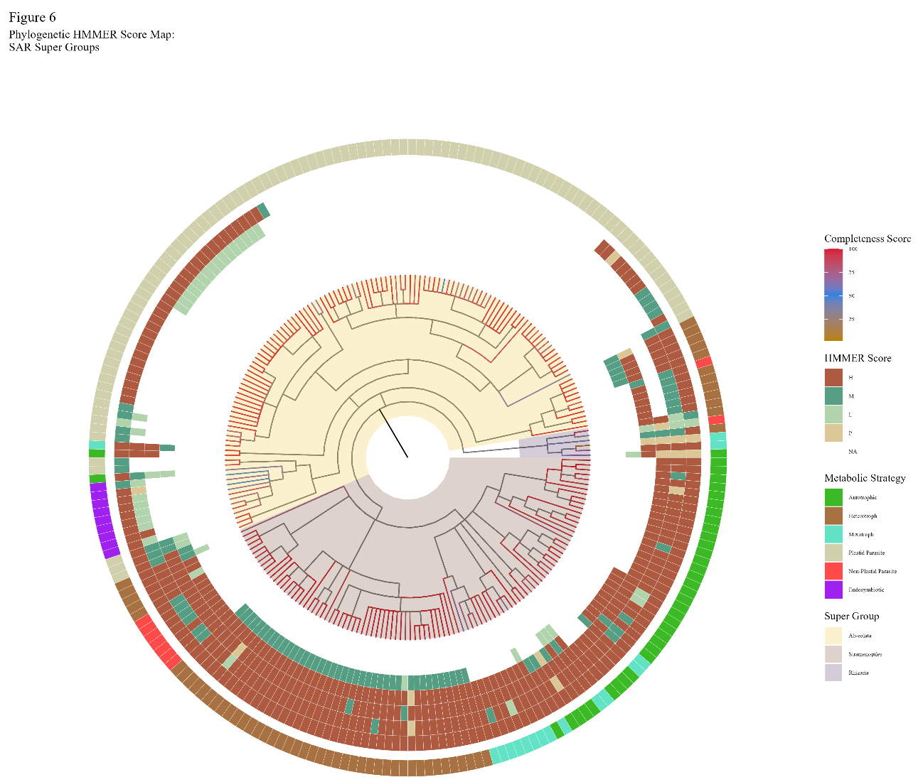

Slide 28

Figure 1
Metamonada
Opisthokonta
Amoebozoa
Discoba
Rhizaria
Streptophyta
Alveolata
Stramenopila
Rhodophyta
Chlorophyta

Slide 29

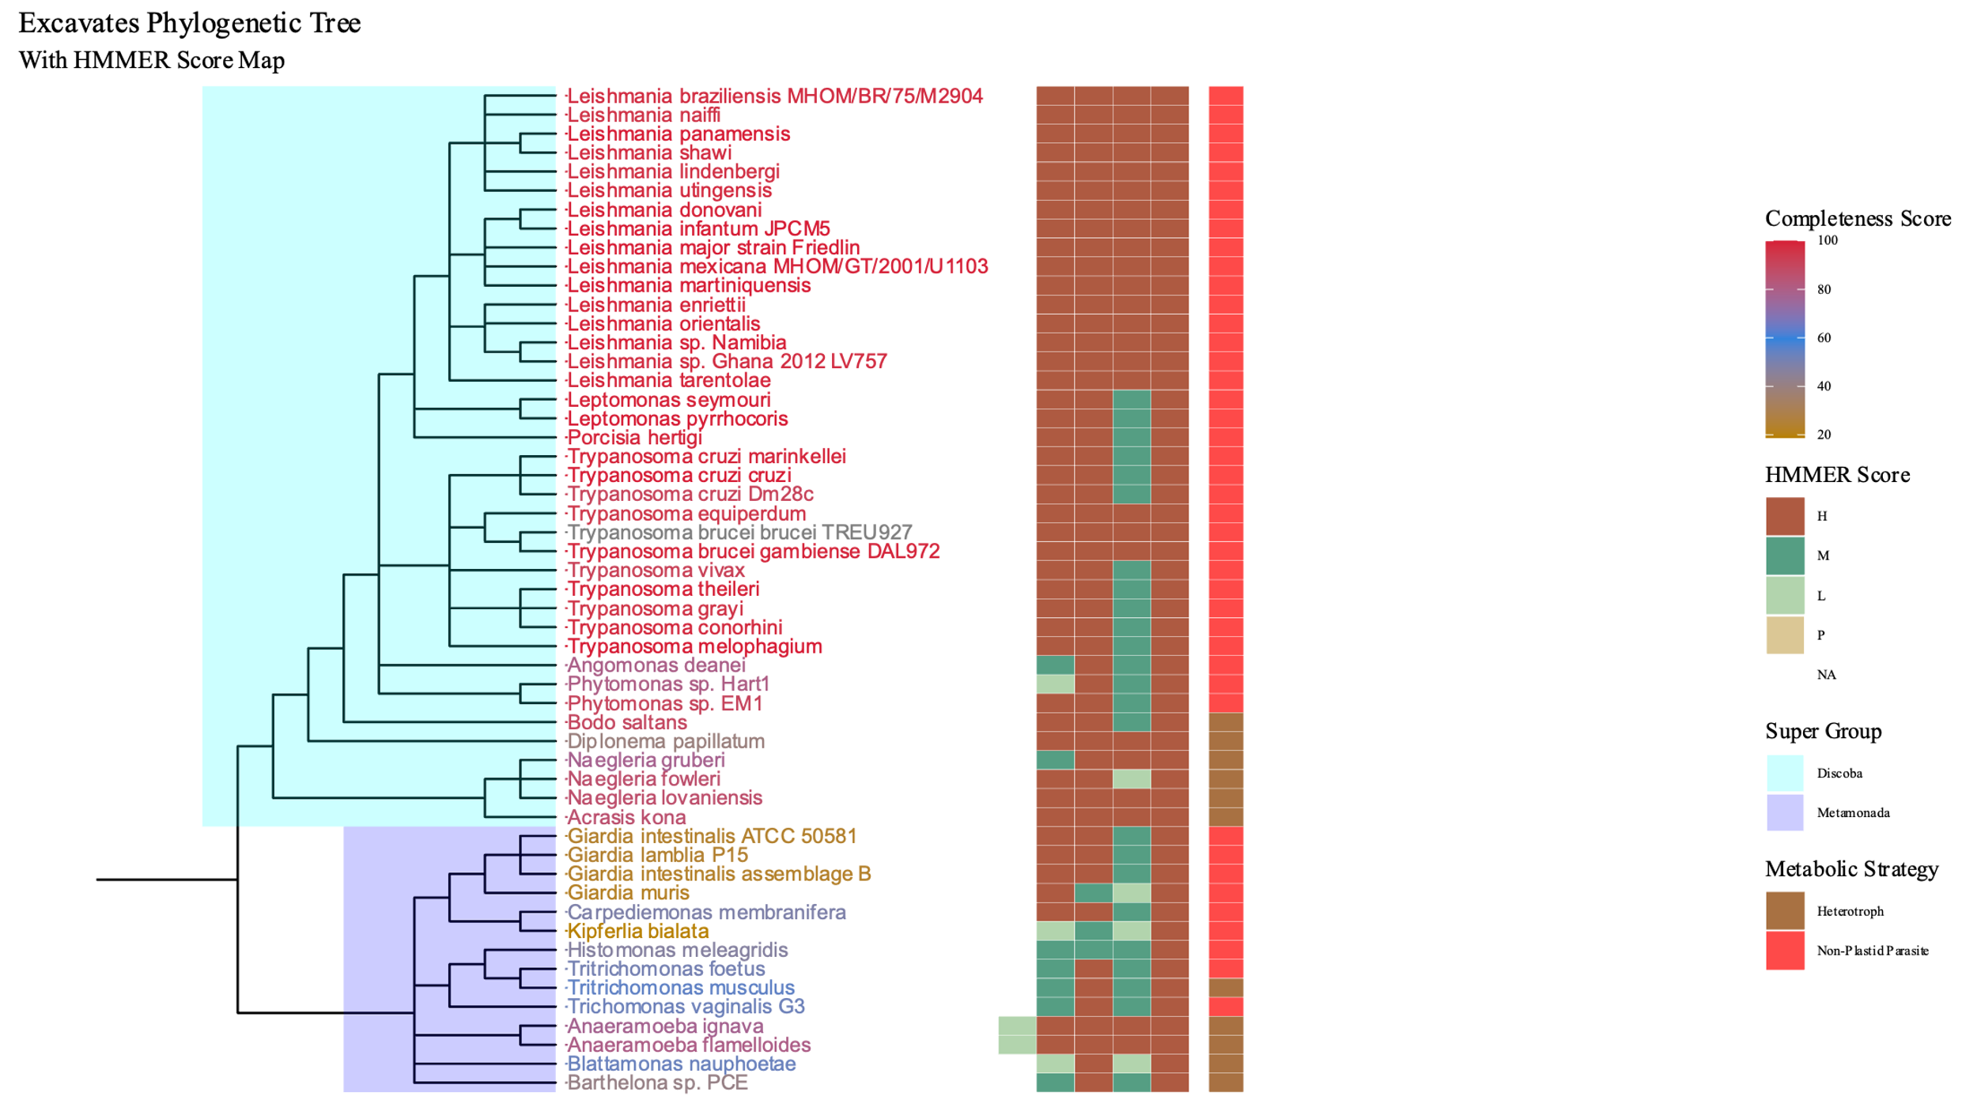
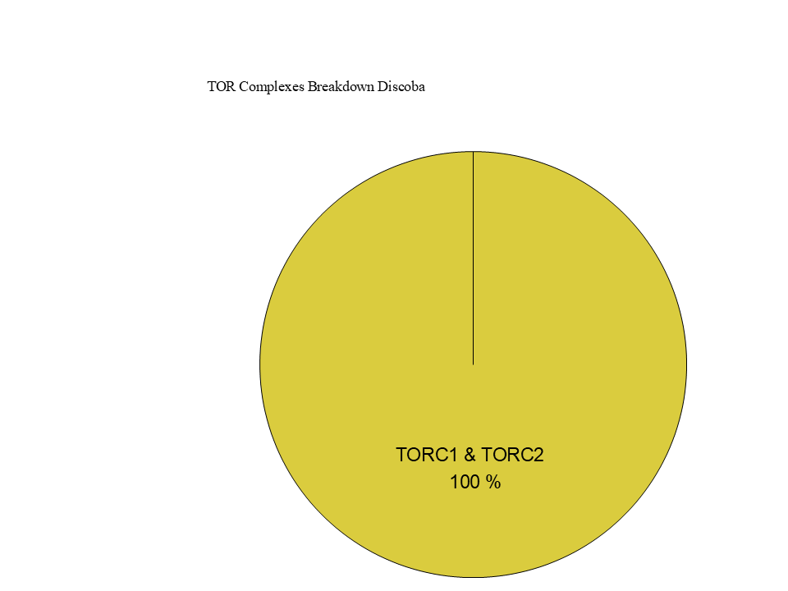
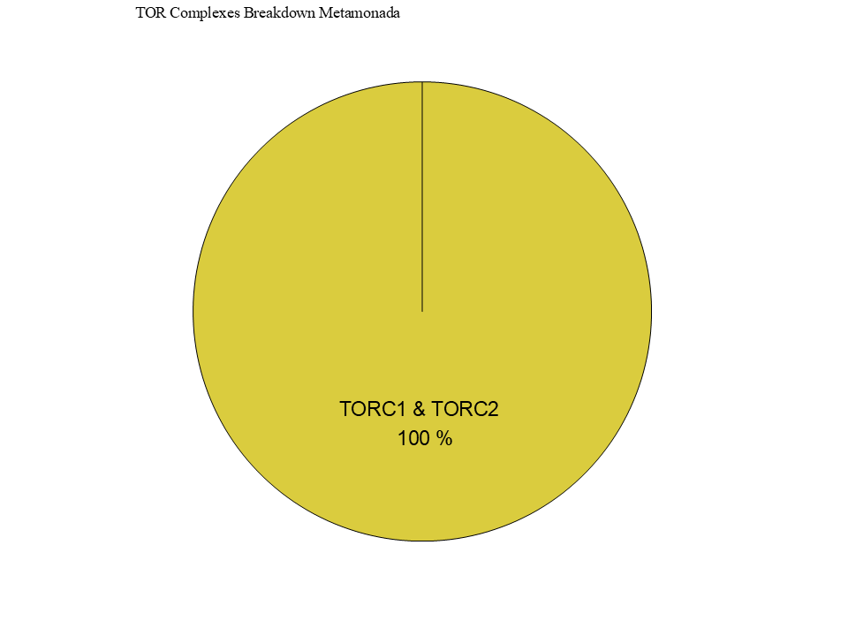
Figure 7

Slide 30
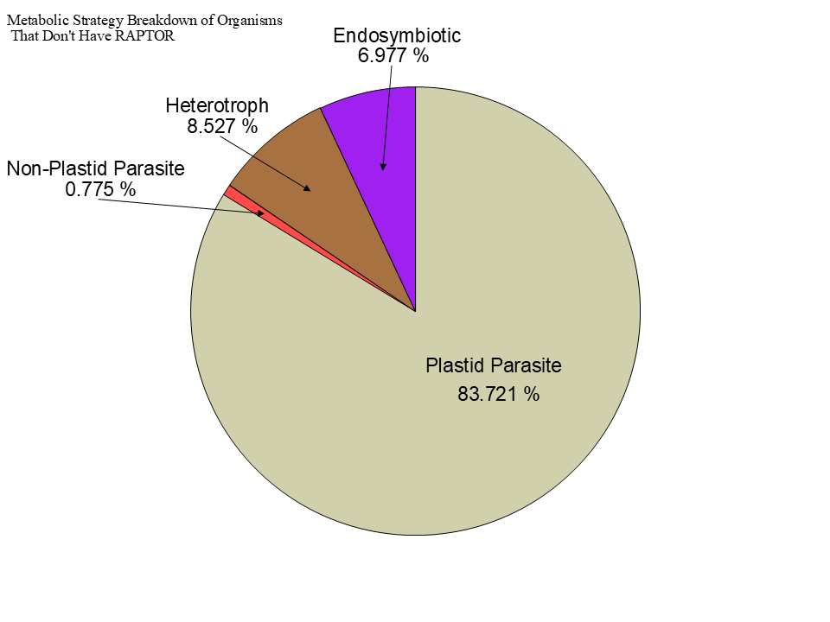
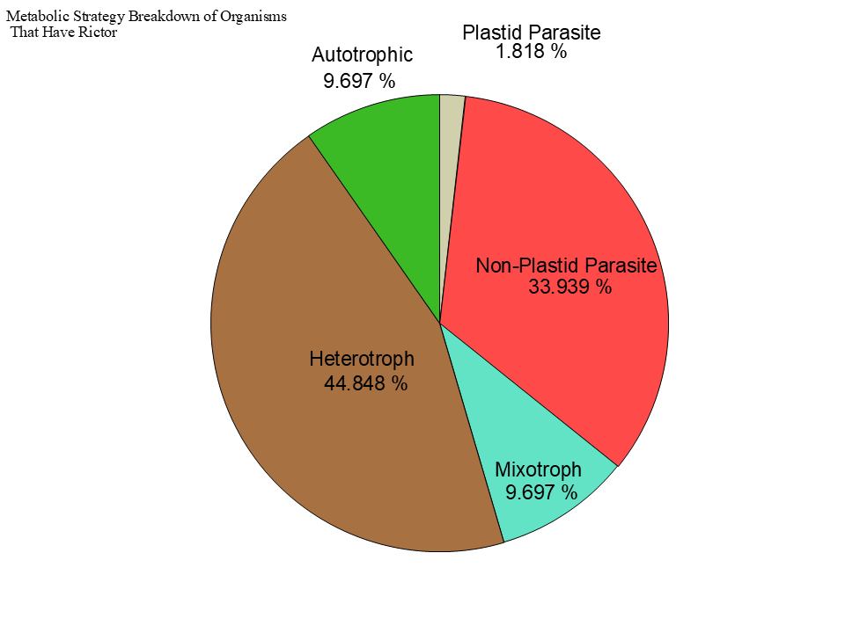
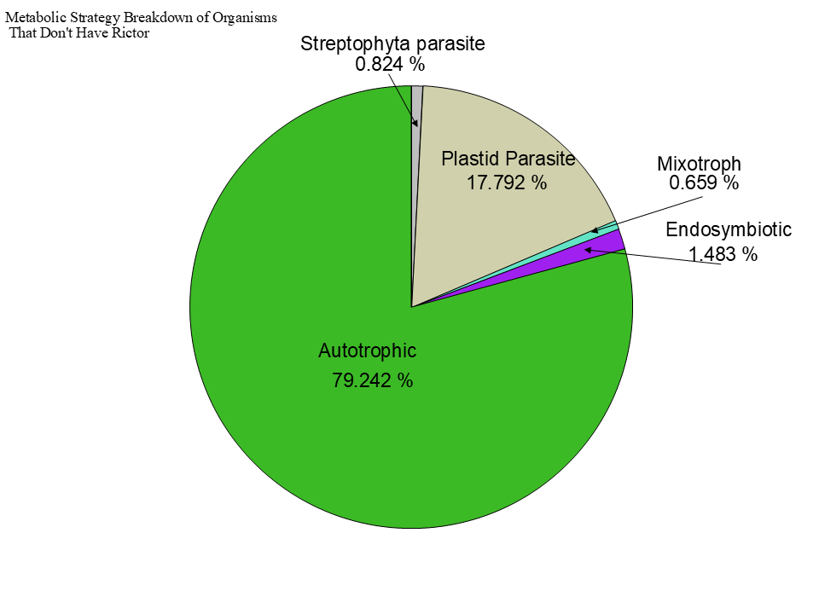

Slide 31
Figure 3

Slide 32




Slide 33


Slide 34


Slide 35


Slide 36

Figure 3
TOR
LST8
RAPTOR
RICTOR
SIN1

Slide 37








Figure 2

Slide 38
Metabolic Strategy
LST8
RICTOR
RAPTOR
SIN1
TOR
Stramenopiles
Alveolata
Rhizaria

